Slide 1
Eat@
Online Food Delivery System
RLL PROJECT BATCH - 6

Slide 2
Team Members
Name of the Developer Employee ID
Prathijna R Udupa 2527946
Pullagura Vamsi 2525905
Rahul Kumar 2525728
Rayala Lokesh 2528561
Rizvi Sultana M A 2530100
S Berlin 2526684
Sangeetha J 2526763
Sanofer Fathima Zahir Hussain 2530388
Santhosh S 2526510
Sarnika K 2527426

Slide 3
Table of Contents
SL NO | CONTENT
1 | Introduction
2 | Functional Requirements
3 | Tools and Technologies
4 | Architectures
5 | Flowcharts
6 | Database Schema
7 | Implementation
8 | Testing

Slide 4
Introduction
To create a dynamic and responsive online food delivery web application for online ordering of food items of different cuisines from a restaurant.
Main Objectives:
To provide a bug free online food delivery system to users as well as admin.
The main aim here is to provide a nice and secure platform for Ordering food.
To maintain the records of product, category available into the system.

Slide 5
Functional Requirements
Admin Functionalities:
1. Login to portal
2. Add or remove cuisines to or from the application to build a rich product line
3. Edit food item details like name, price, cuisine and description.
4. Delete food items
Add Dish
Edit Dish
Delete Dish
Login
Admin Stories

Slide 6
User Functionalities:
1. Register to the application
2. Sign into the application to maintain the record of activities
3. Search for food items based on the search keyword
4. Apply filters and sort results based on different cuisines
5. Add all the selected food items to a cart and customize the purchase at the end
6. Perform a payment process
7. Summary of the order
Search
Product
Login
Add to Cart
Buy the Product
Register
User Stories

Slide 7
Tools And Technologies
Technologies:
Angular
Java Spring Boot
MySQL
Tools:
1.Visual Studio Code
2. Spring Tool Suite
3.MySQL Workbench
Server:
Tomcat

Slide 8
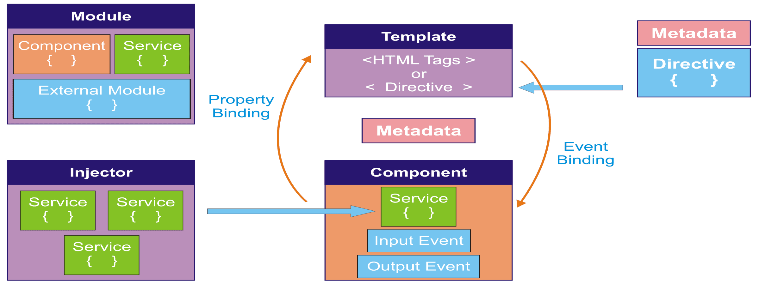
Angular Architecture

Slide 9
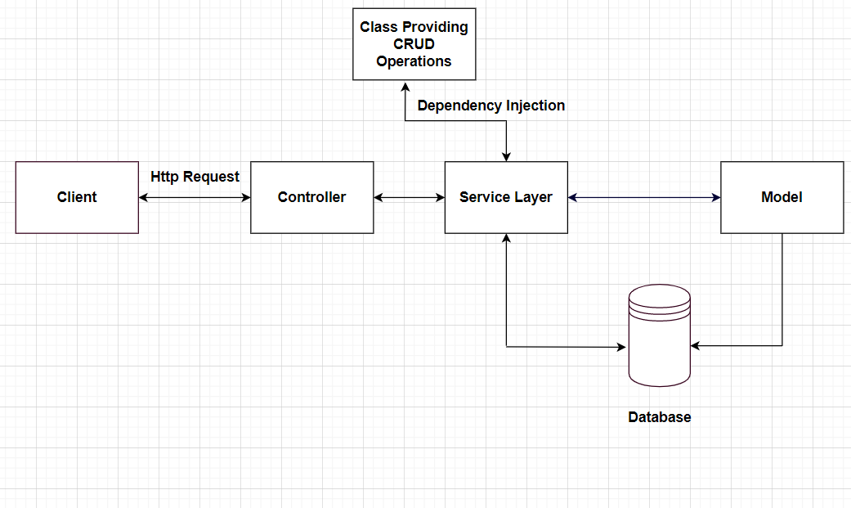
Spring Boot Architecture

Slide 10
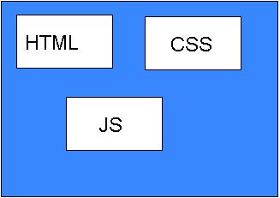
Total Project View
Back-end
Front-end
Backend Lang Application
Database
Web Browser
Web Server
User

Slide 11
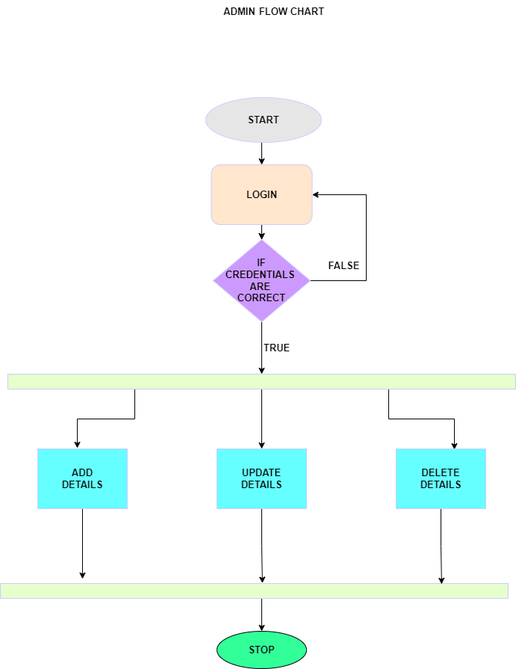
Admin Flowchart:

Slide 12
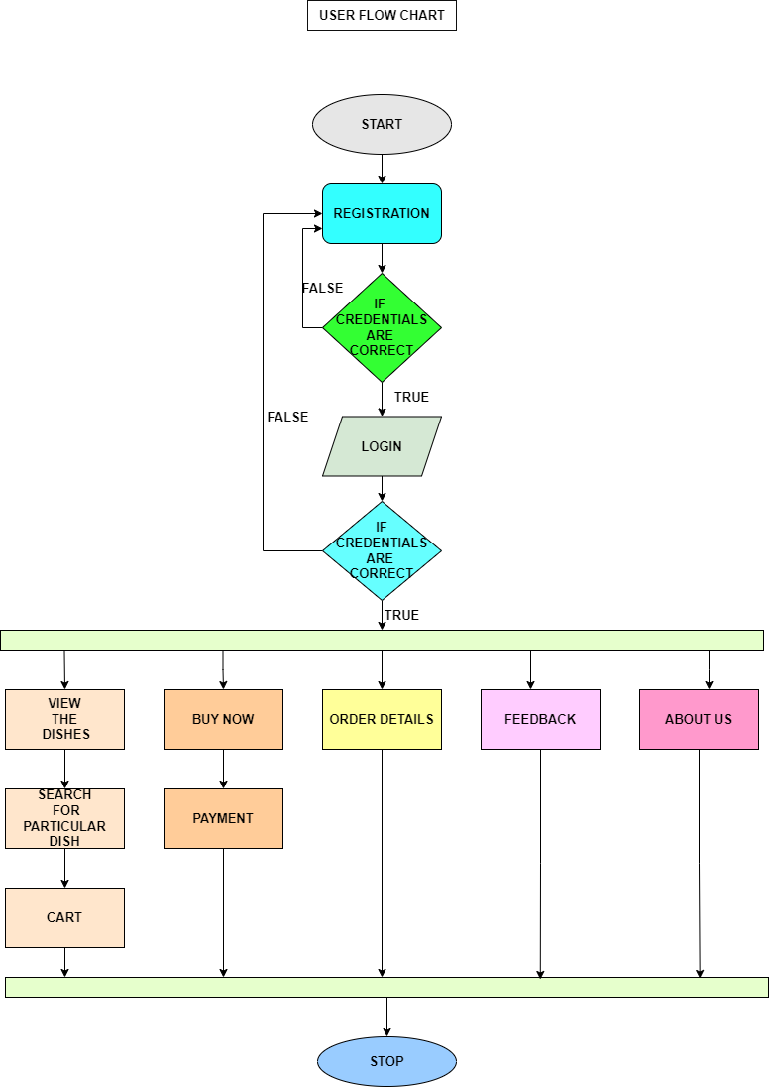
User Flowchart

Slide 13
Database Architecture
Entities in the Database:
User
Dish
Cart
OrderDetails

Slide 14
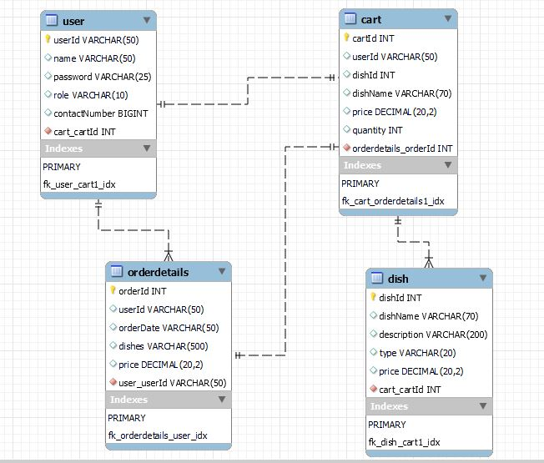
Database Schema

Slide 15
IMPLEMENTATION

Slide 16
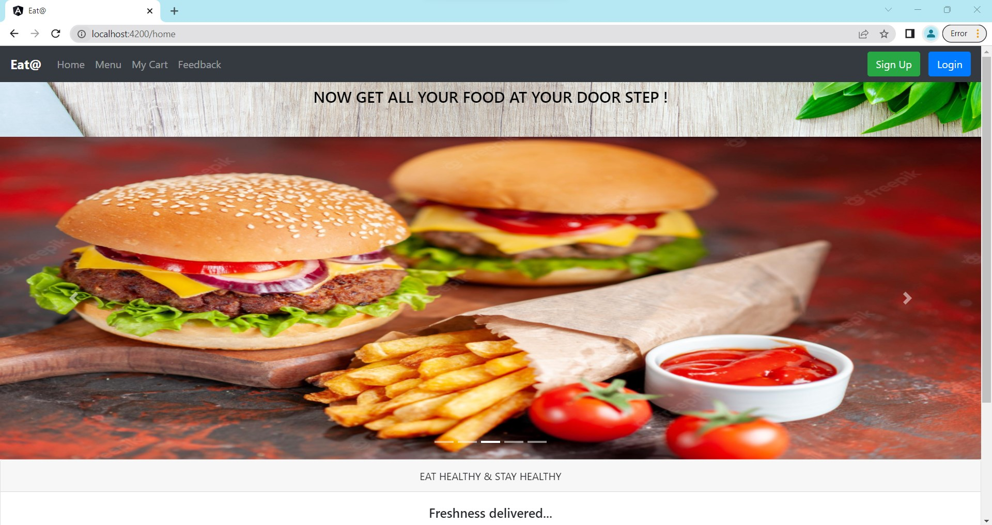

Slide 17
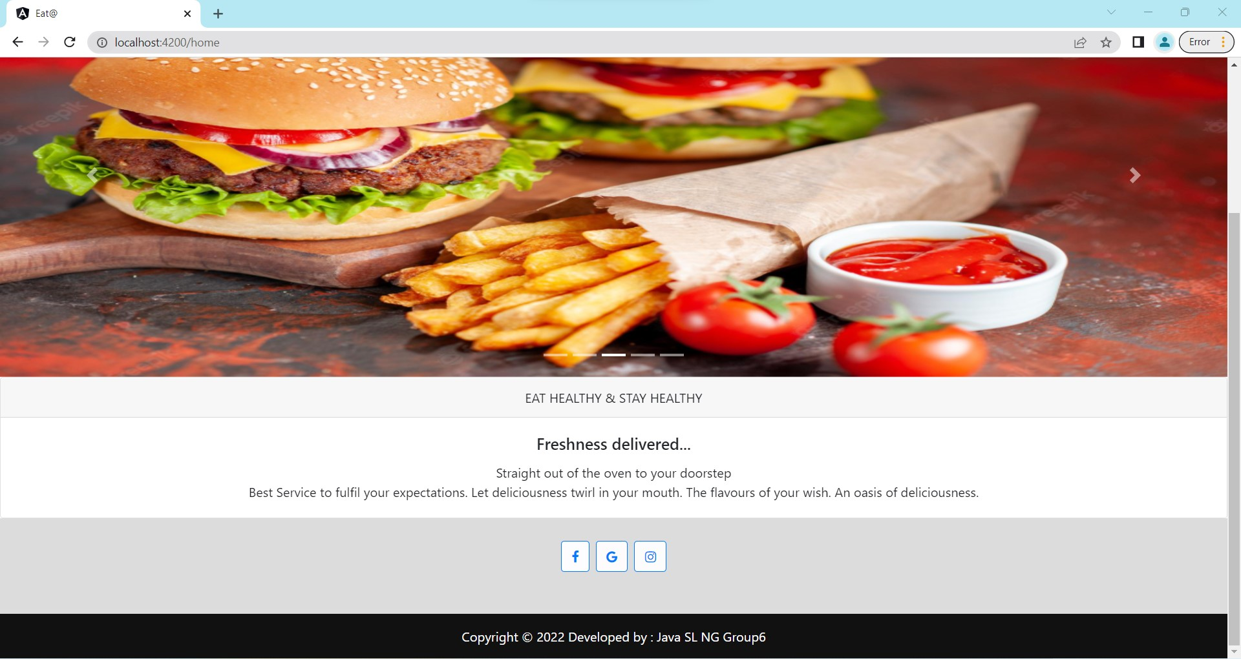

Slide 18
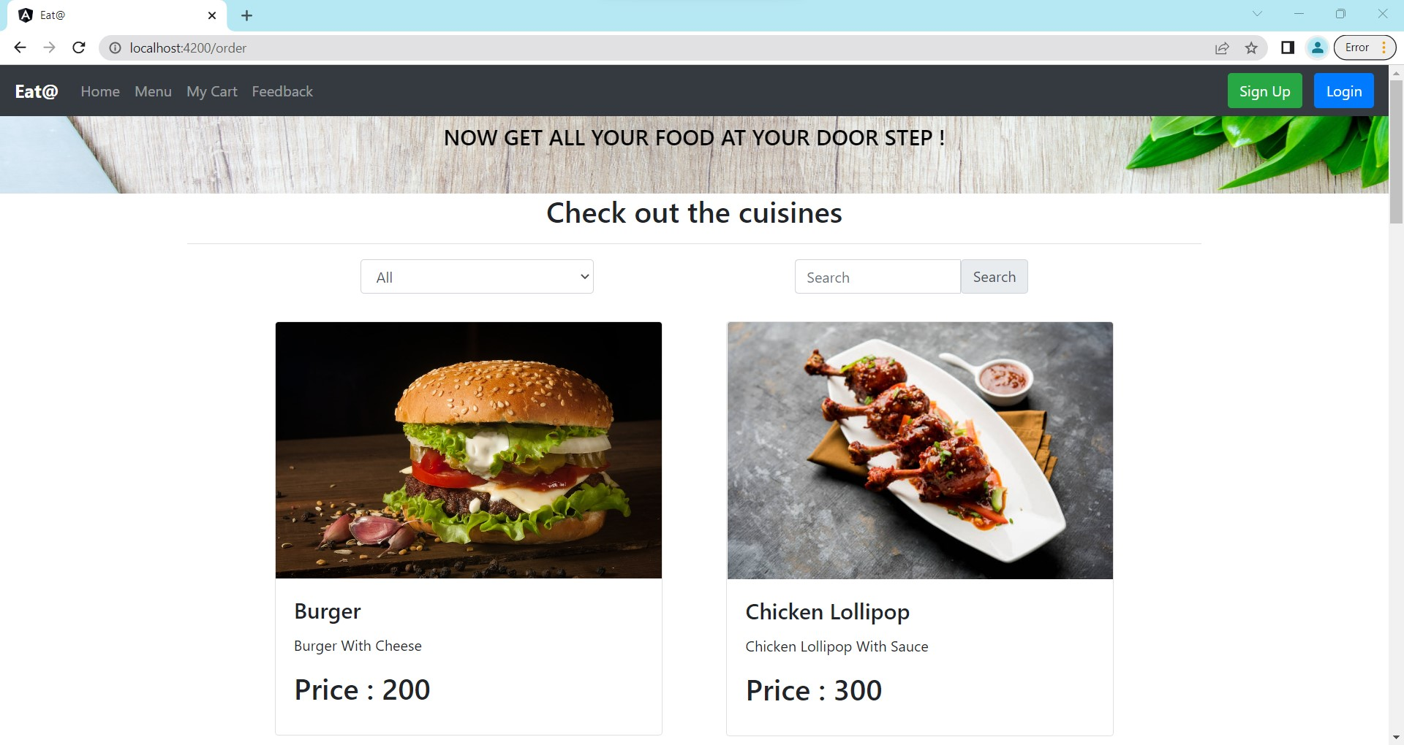

Slide 19
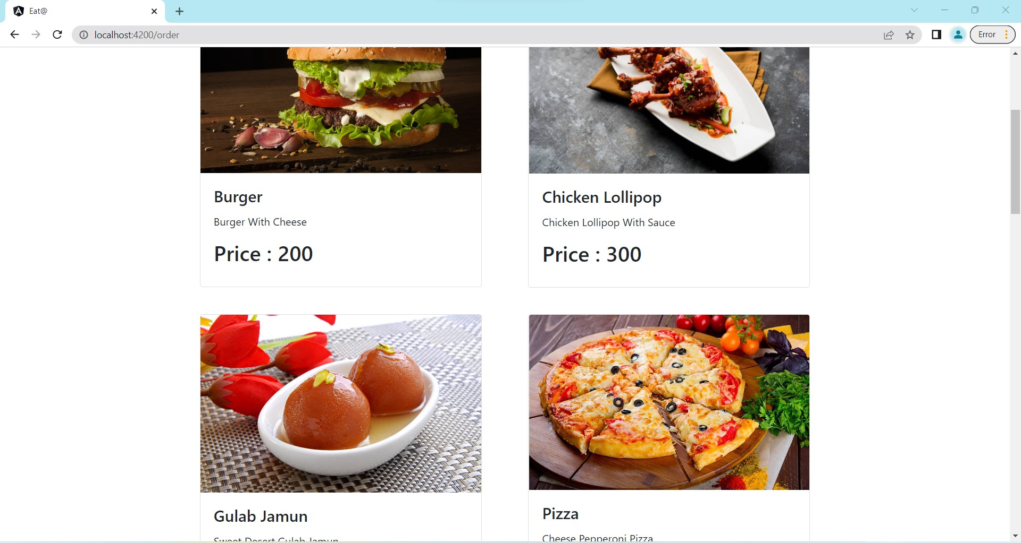

Slide 20
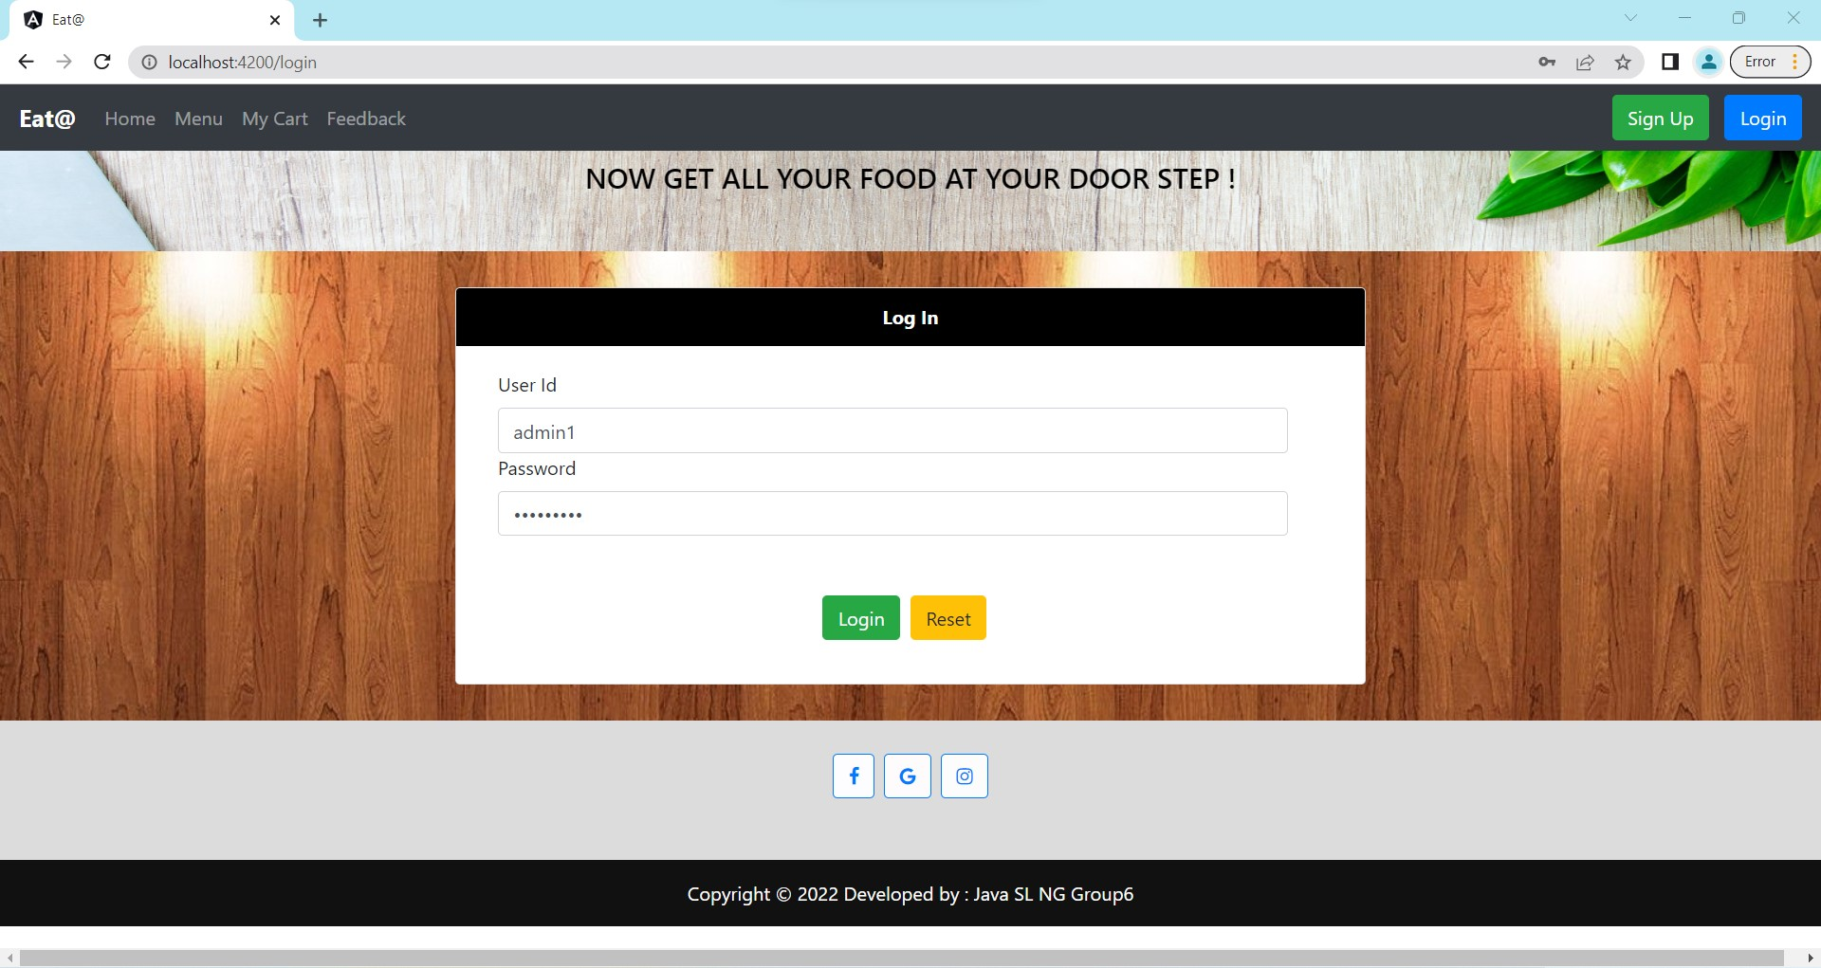

Slide 21
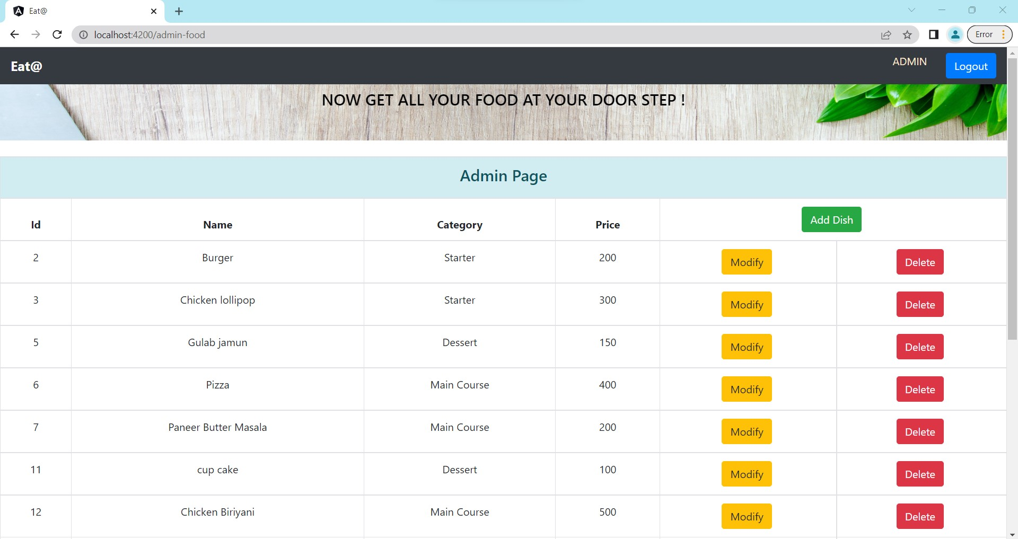

Slide 22
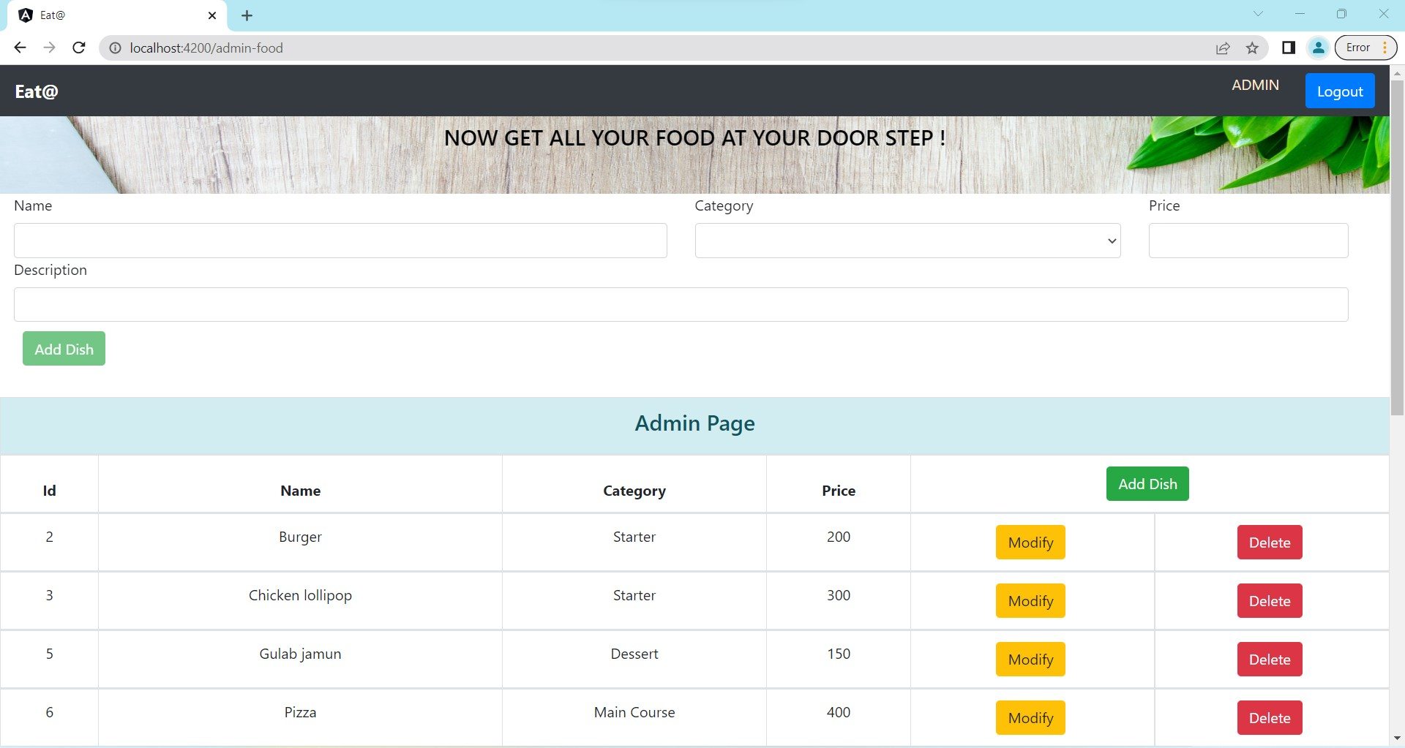

Slide 23
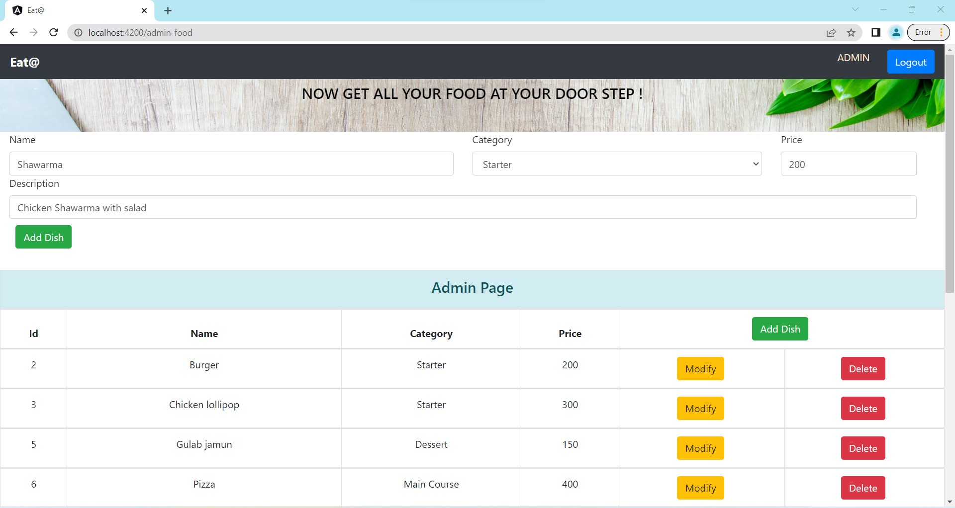

Slide 24
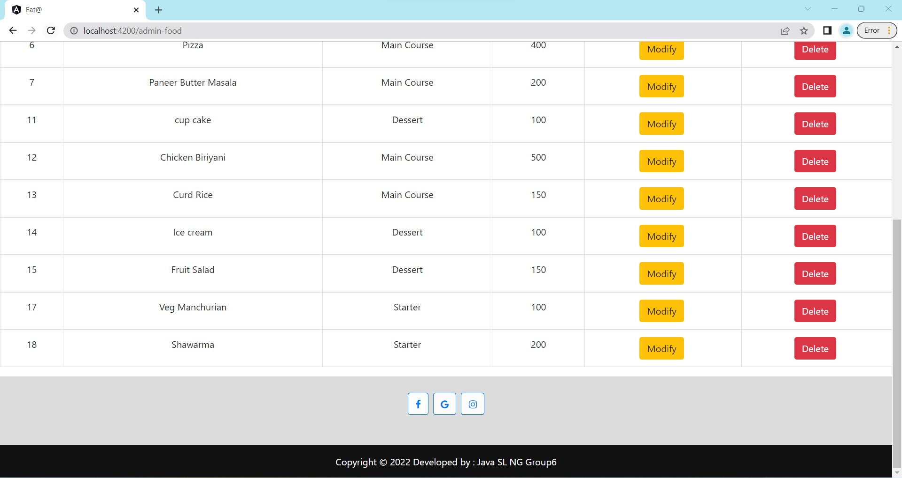

Slide 25
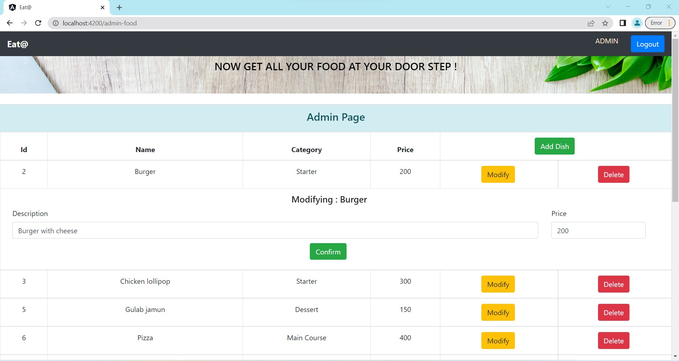

Slide 26
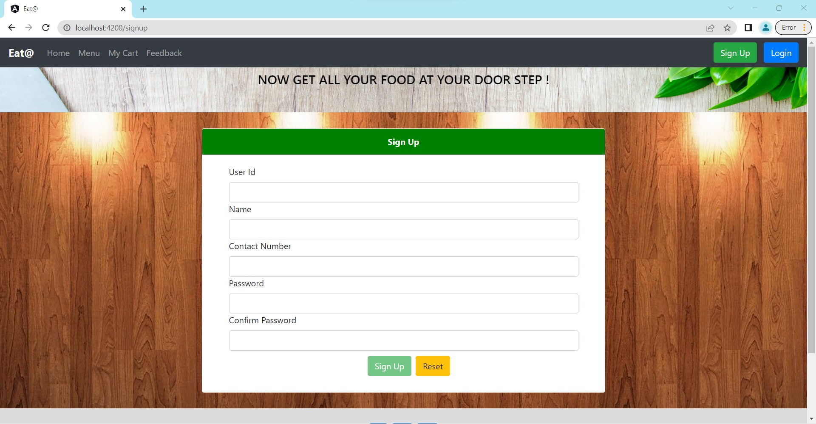

Slide 27
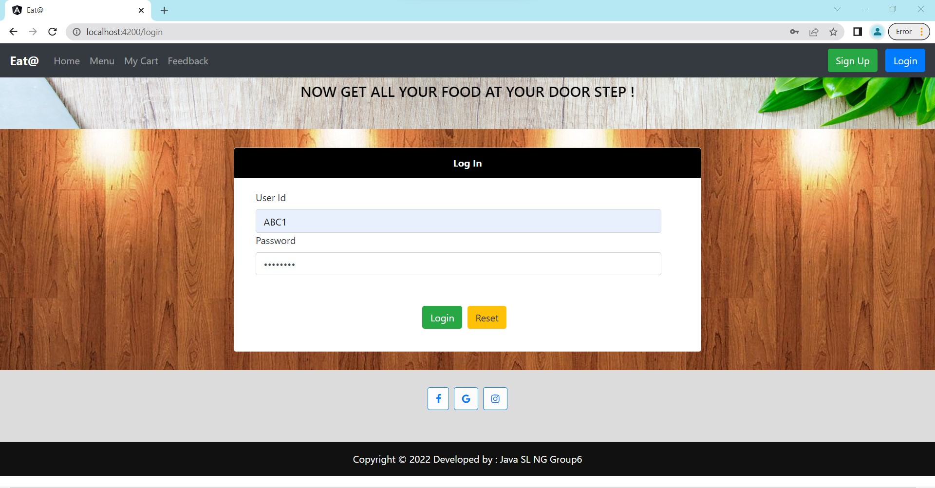

Slide 28
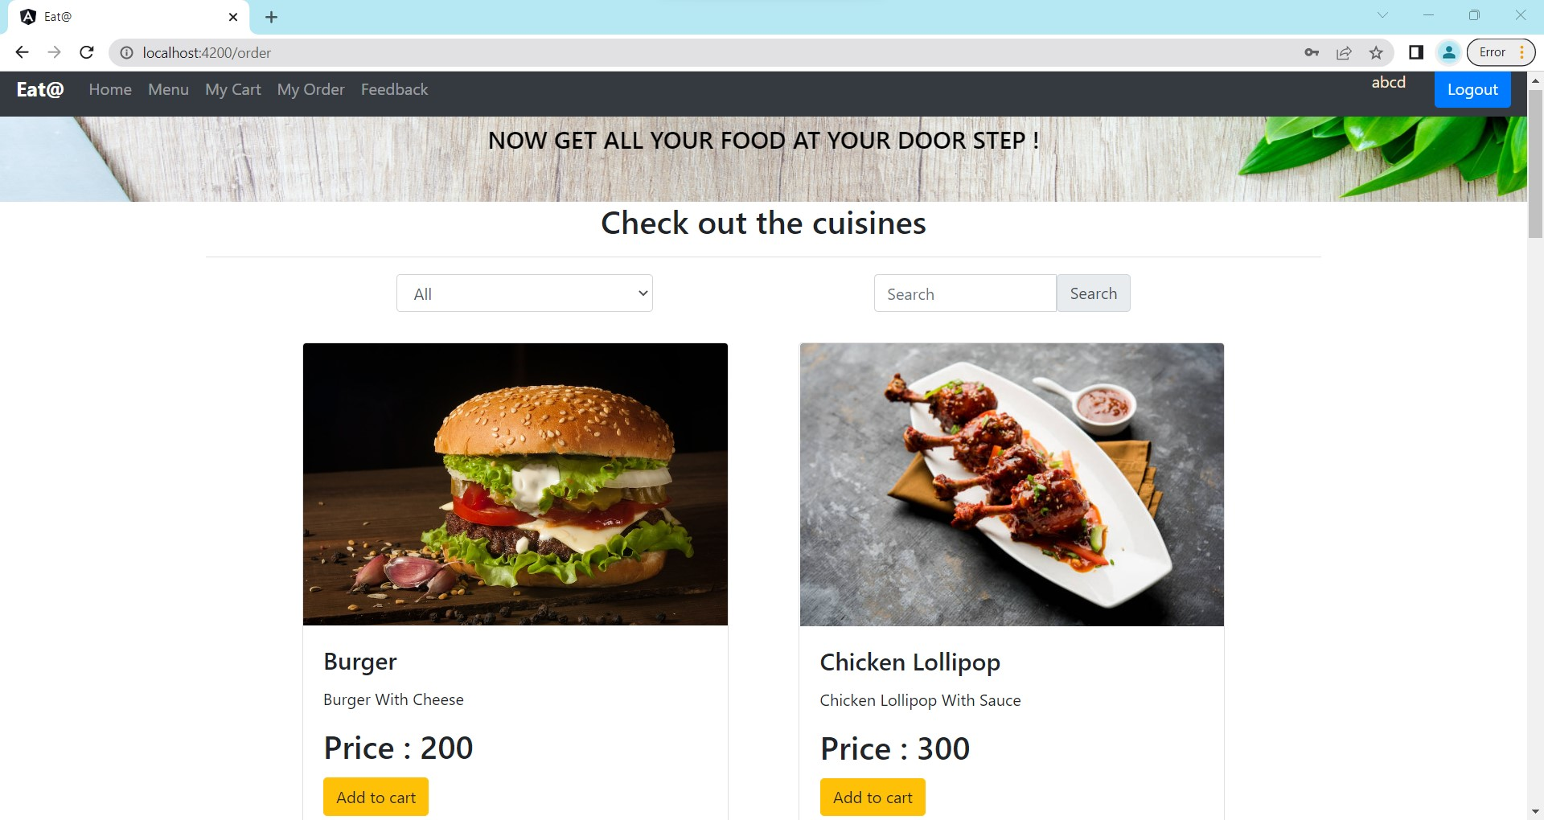

Slide 29
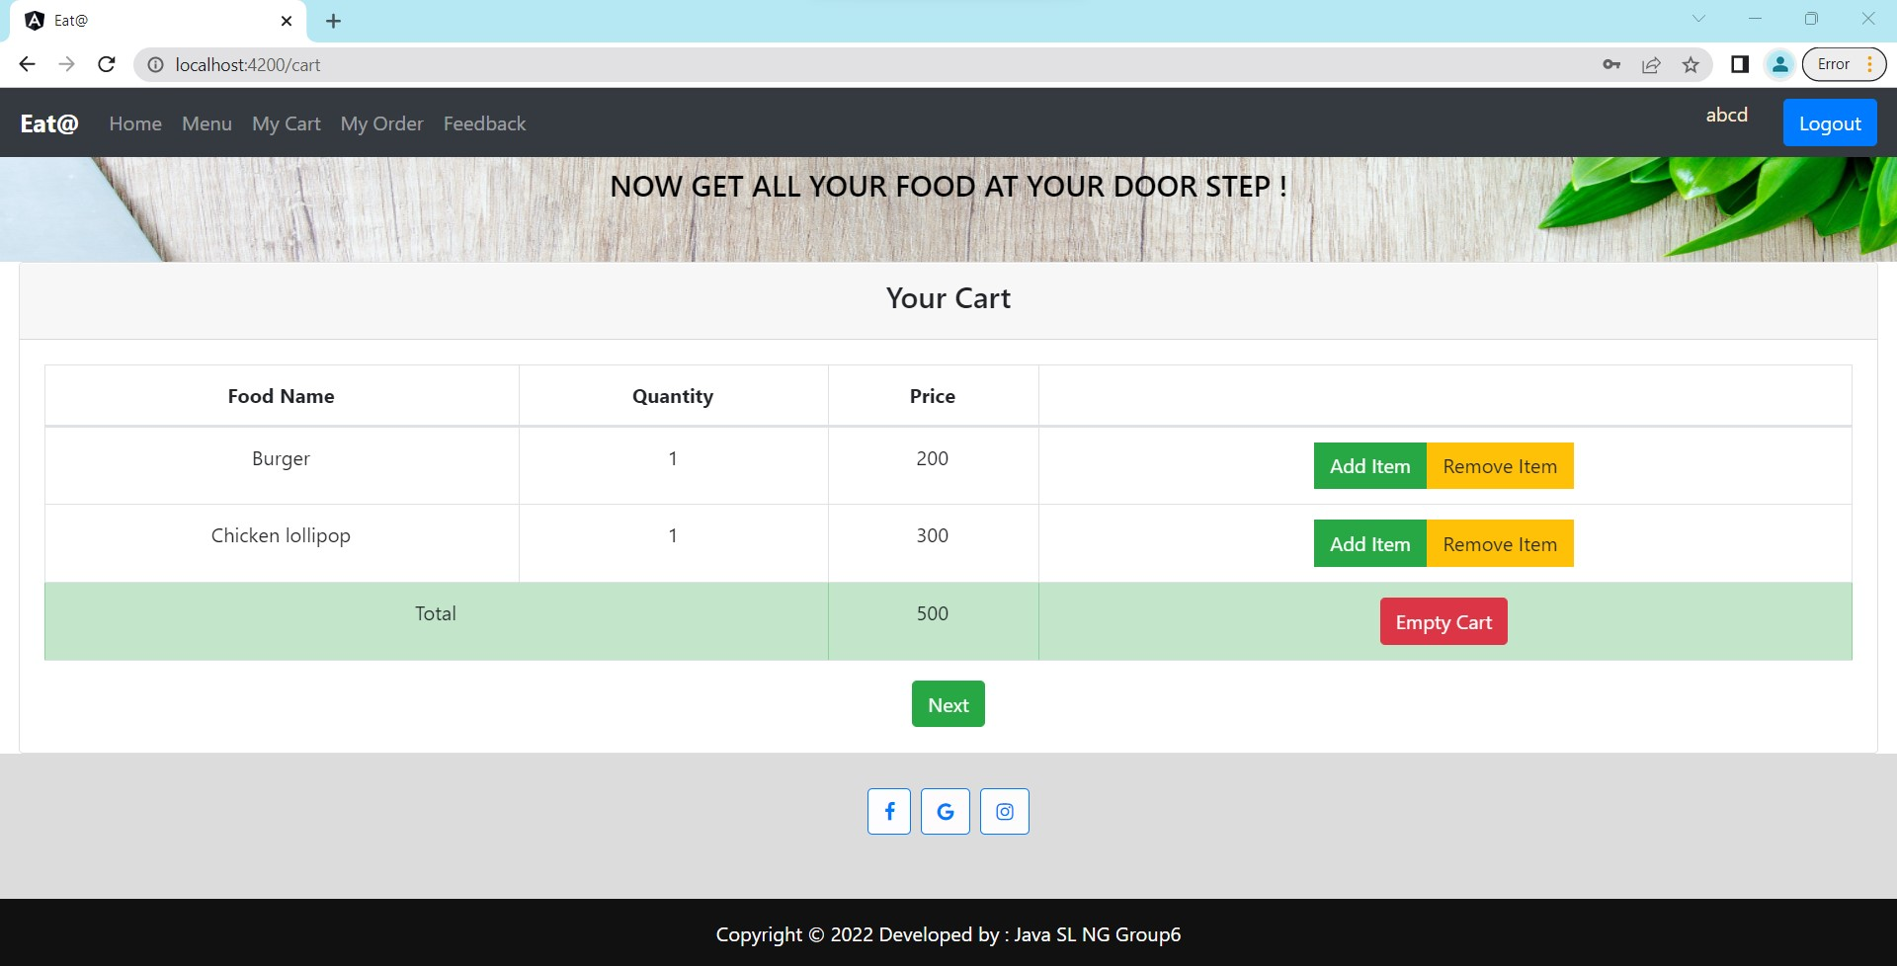

Slide 30
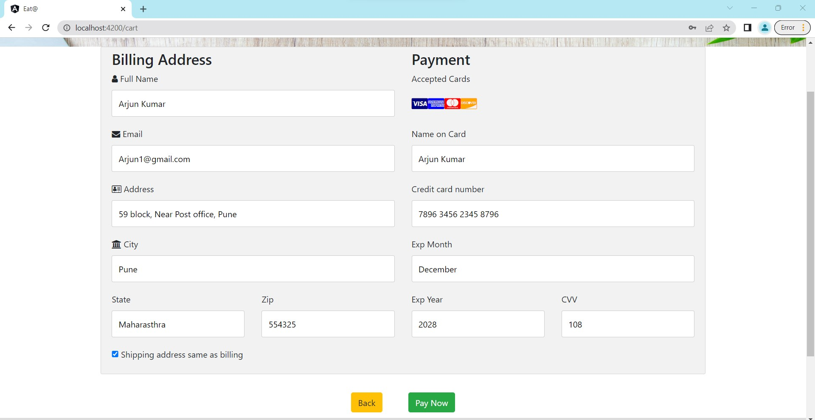

Slide 31
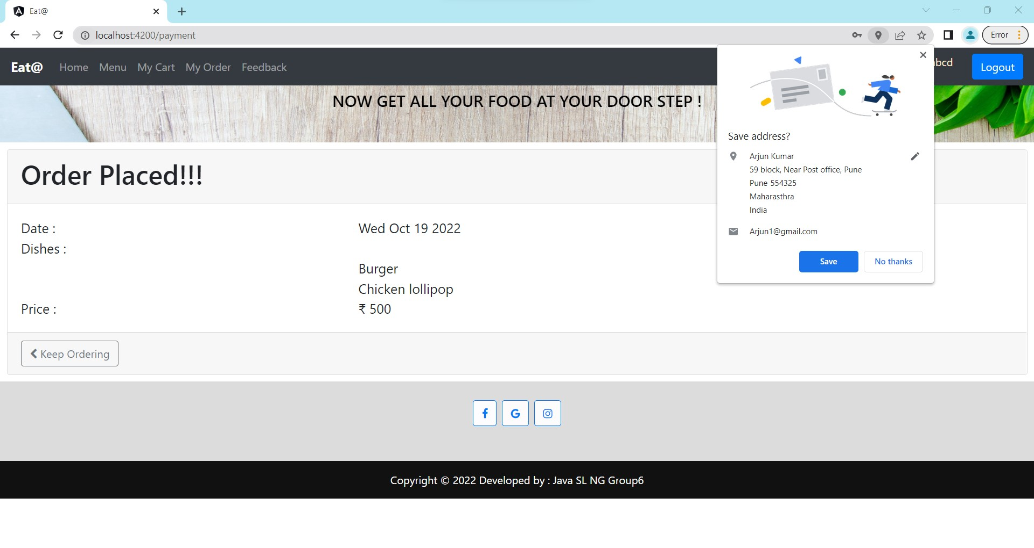

Slide 32
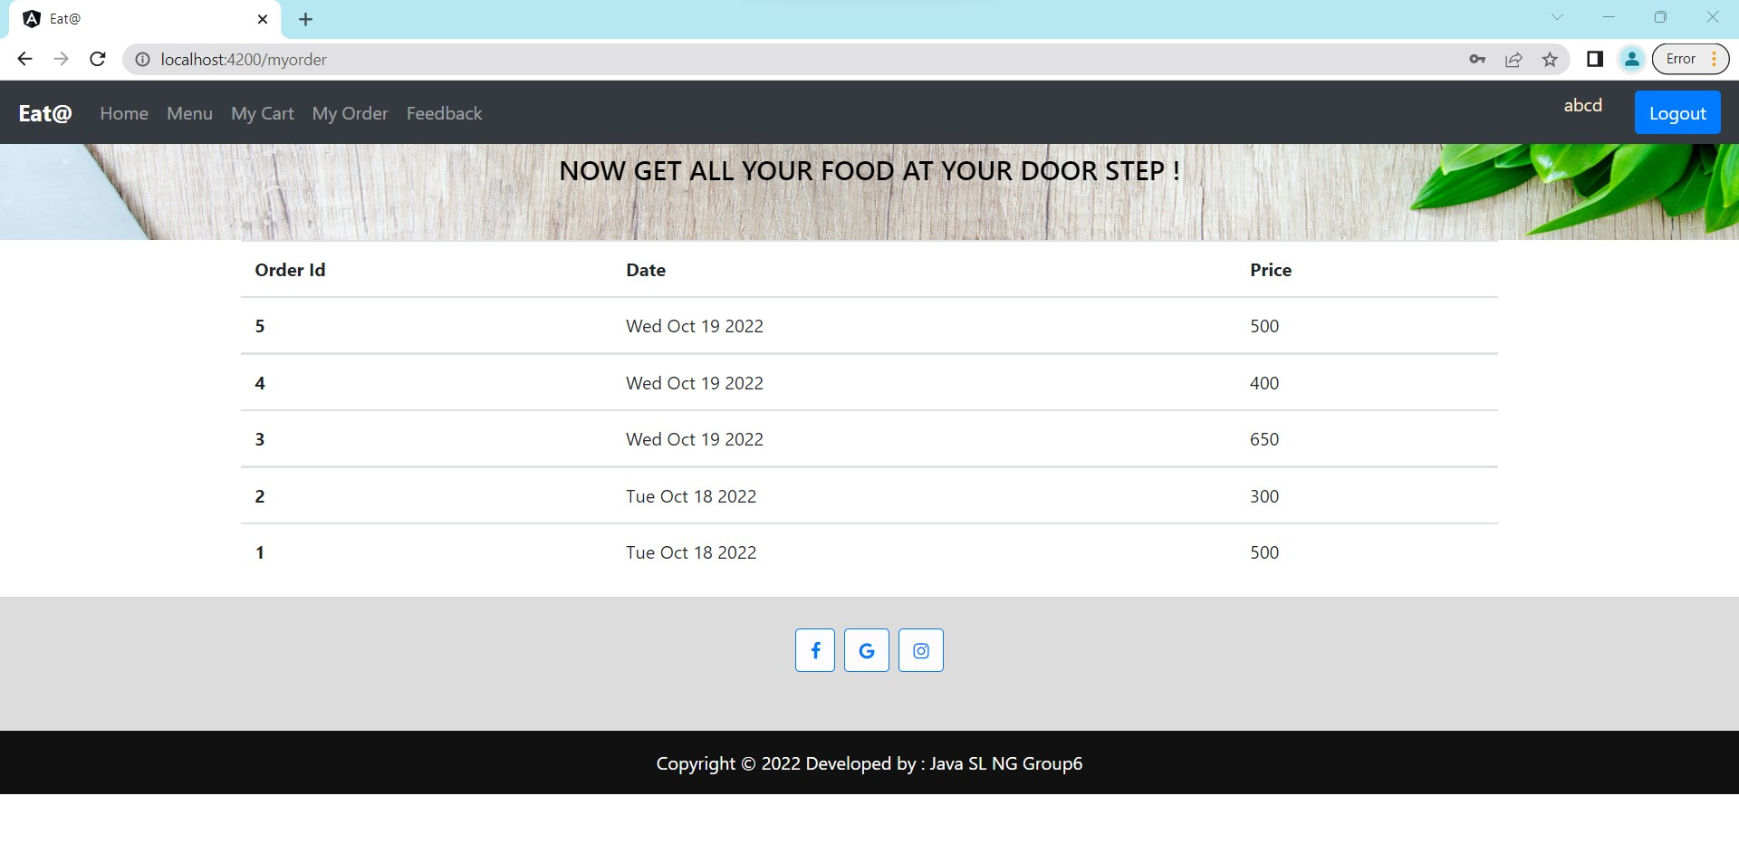

Slide 33
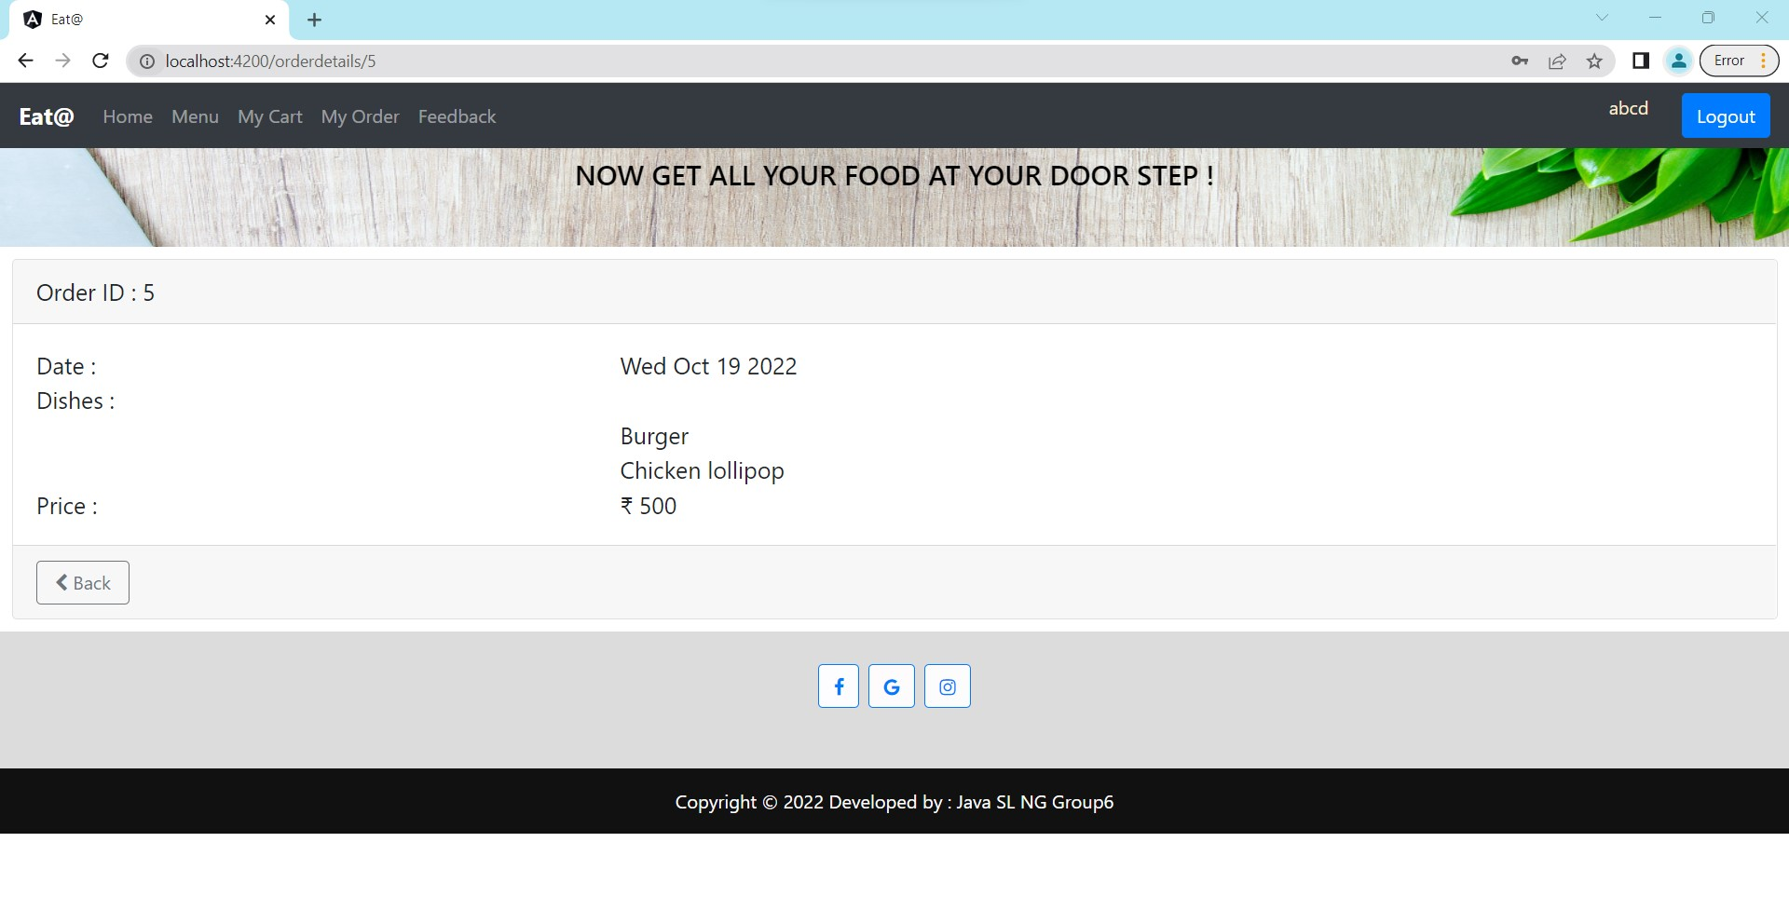

Slide 34
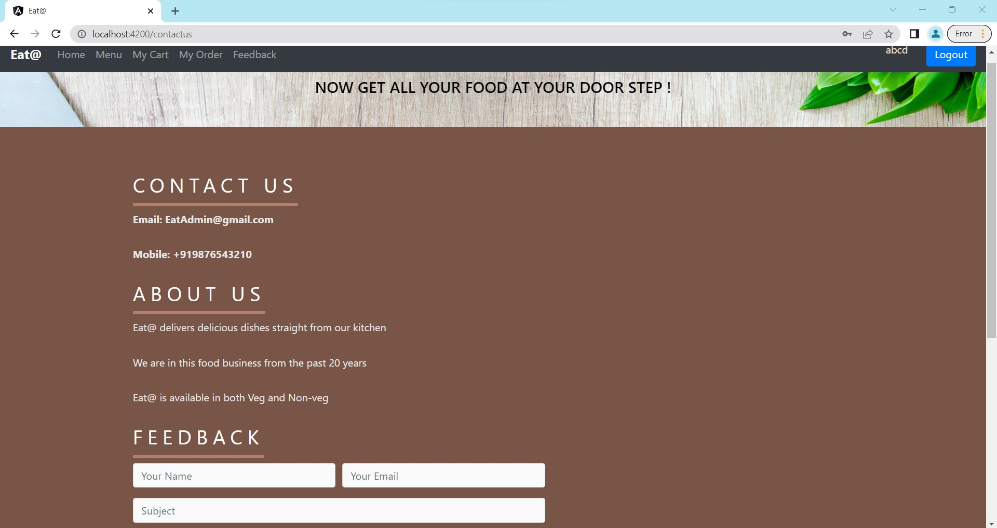

Slide 35
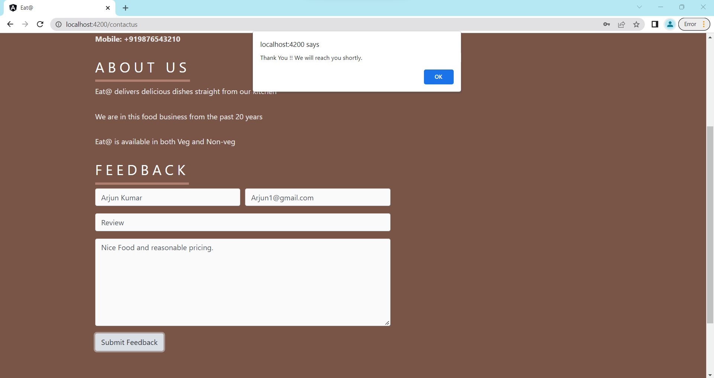

Slide 36
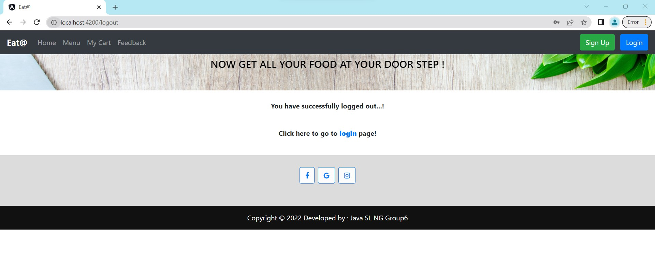

Slide 37
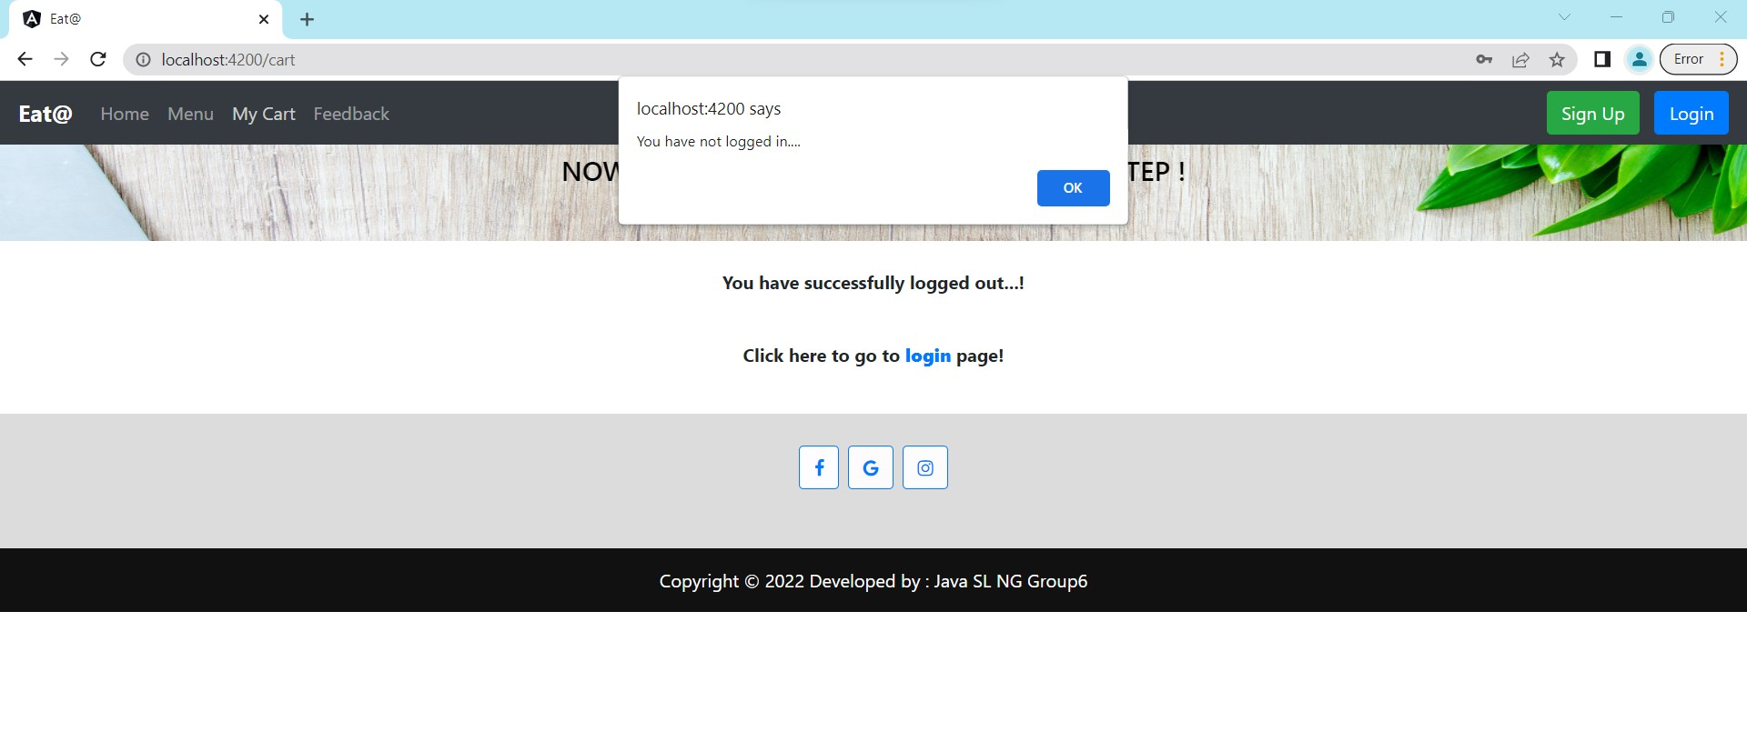

Slide 38
TESTING

Slide 39
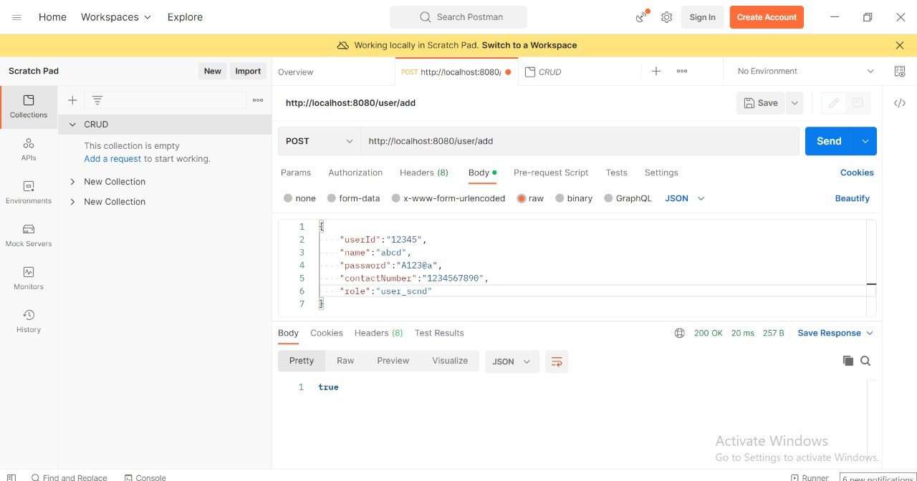
USER
POST:

Slide 40
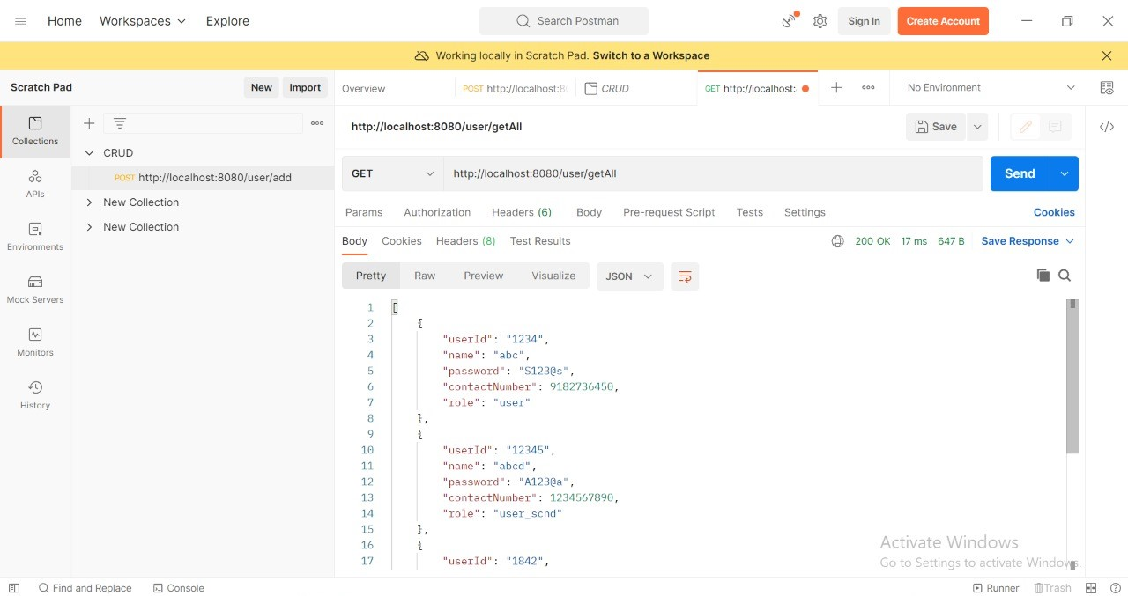
GET ALL:

Slide 41
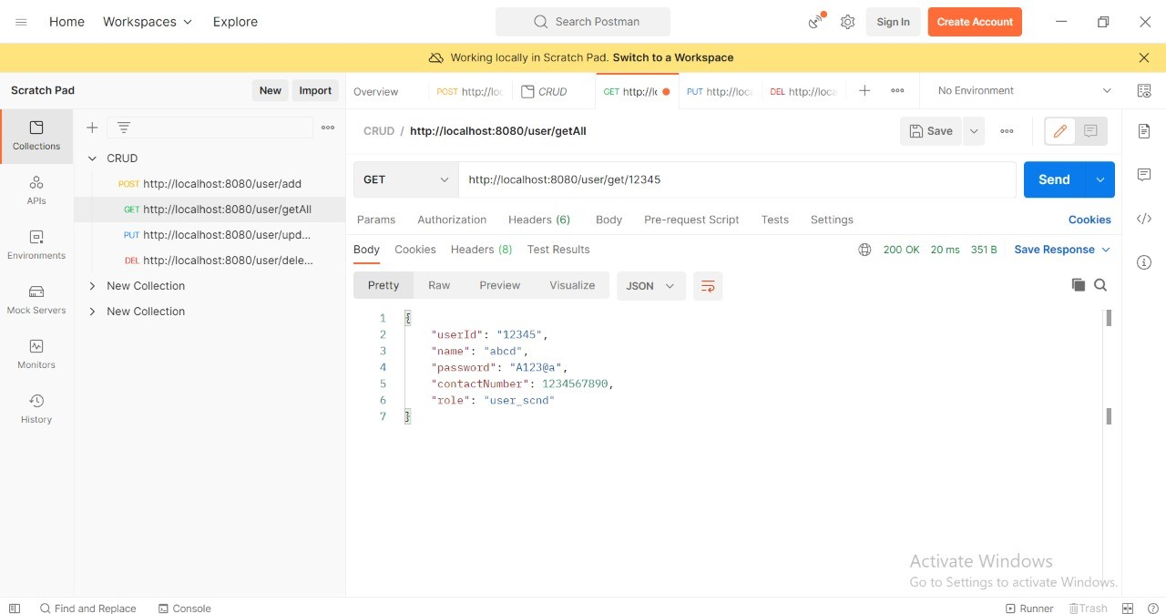
GET with UserId:

Slide 42
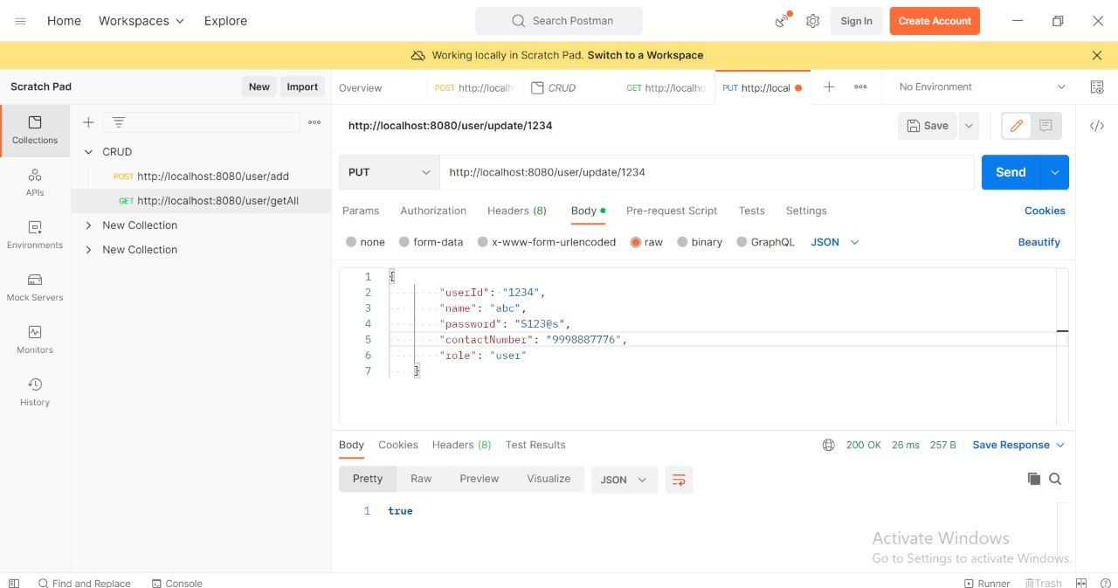
UPDATE:

Slide 43
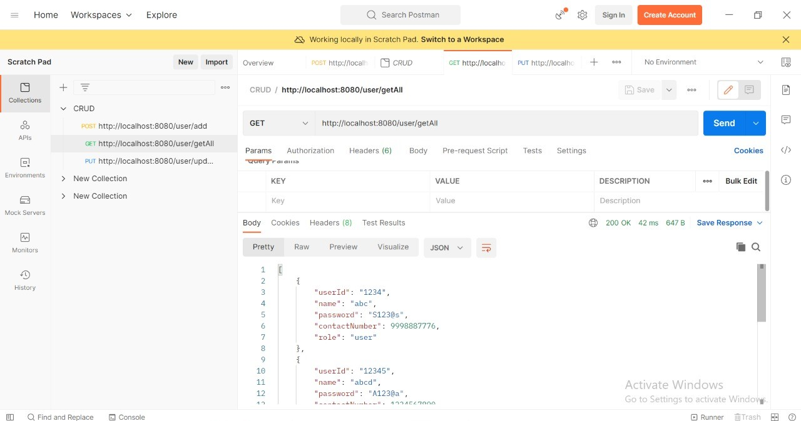
AFTER UPDATE:

Slide 44
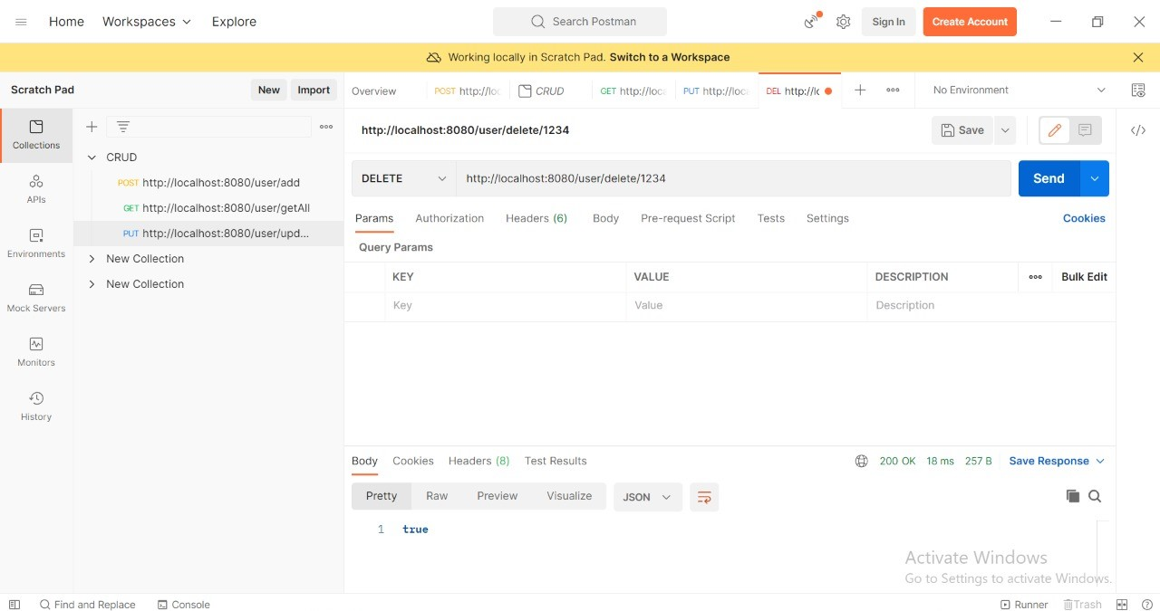
DELETE:

Slide 45
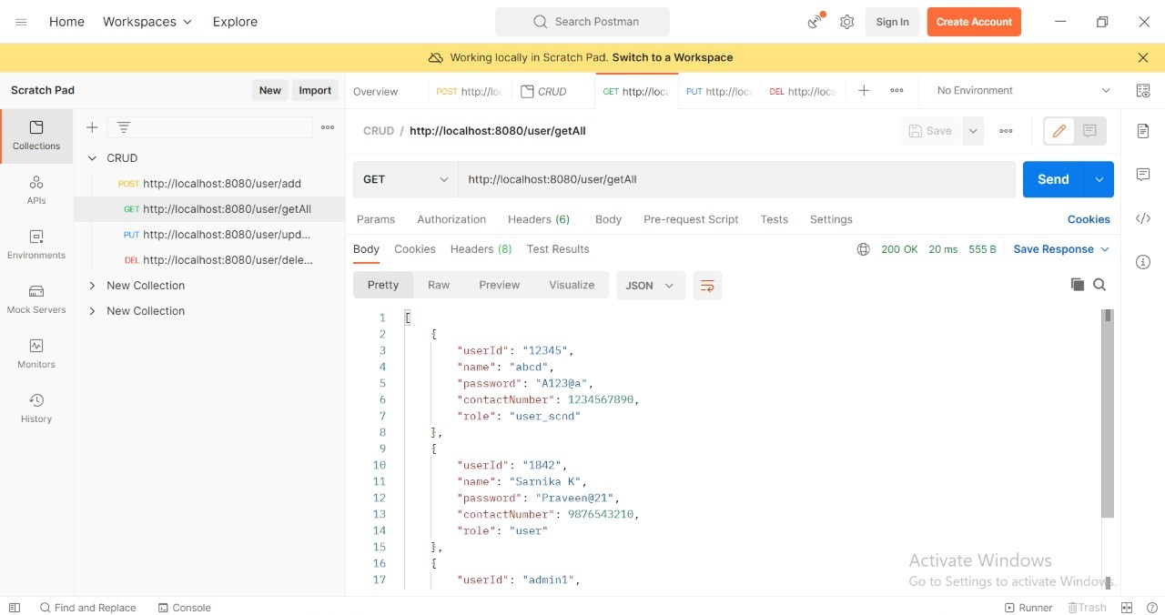
AFTER DELETE:

Slide 46
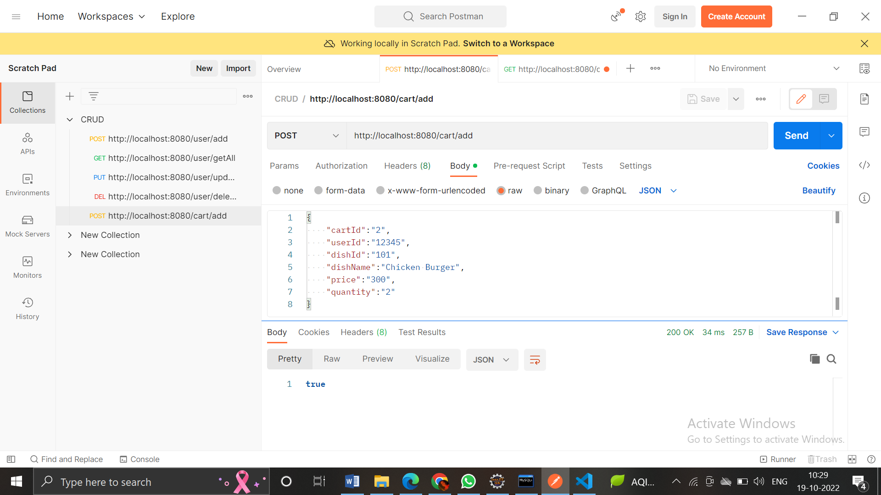
CART
POST:

Slide 47
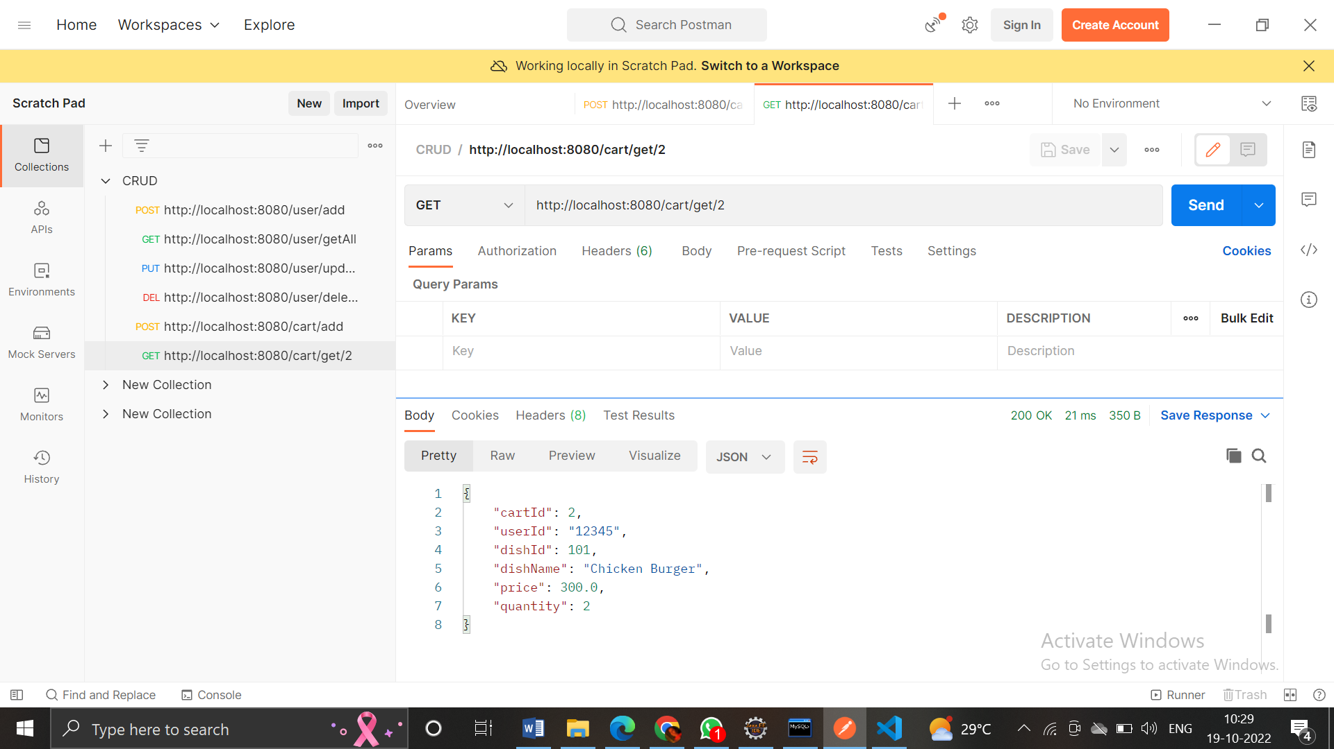
GET:

Slide 48
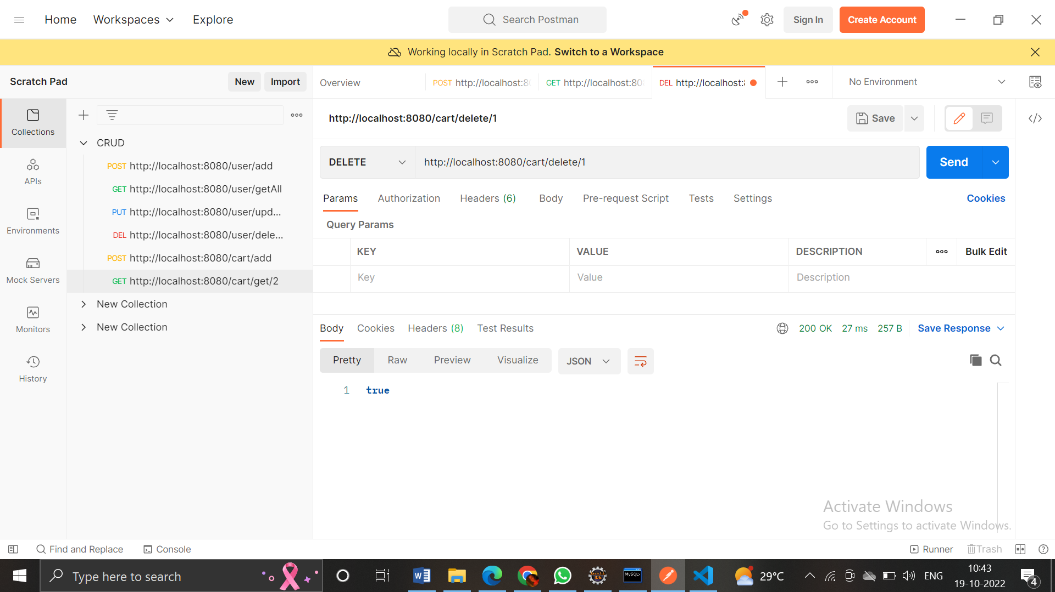
DELETE:

Slide 49
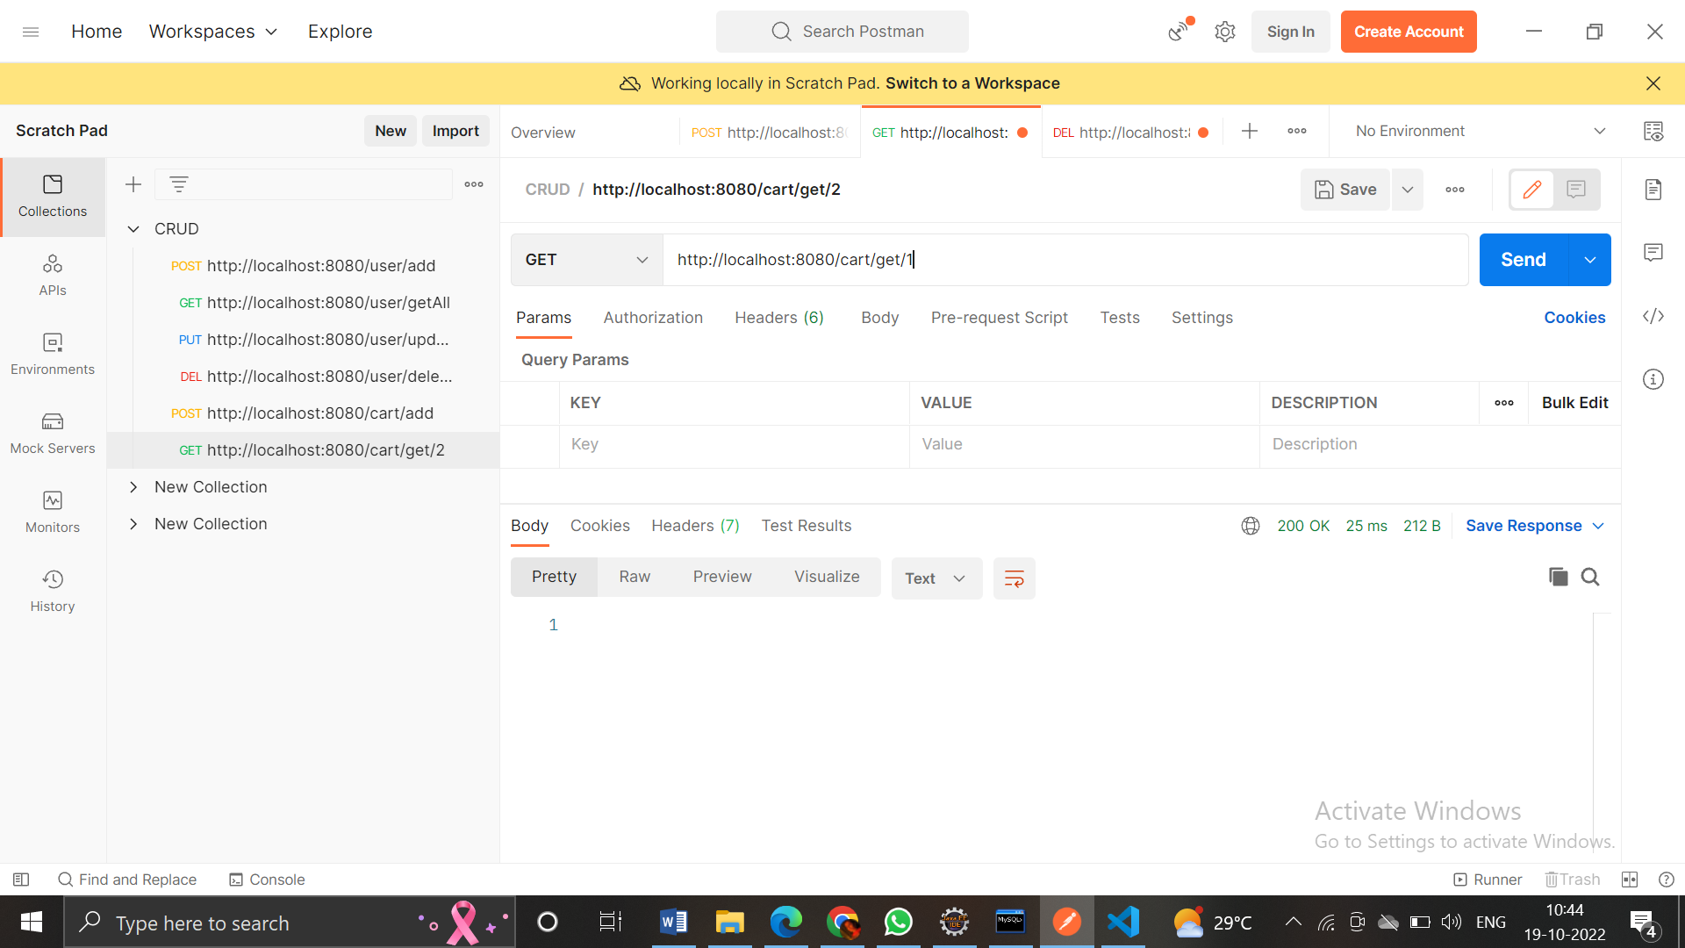

Slide 50
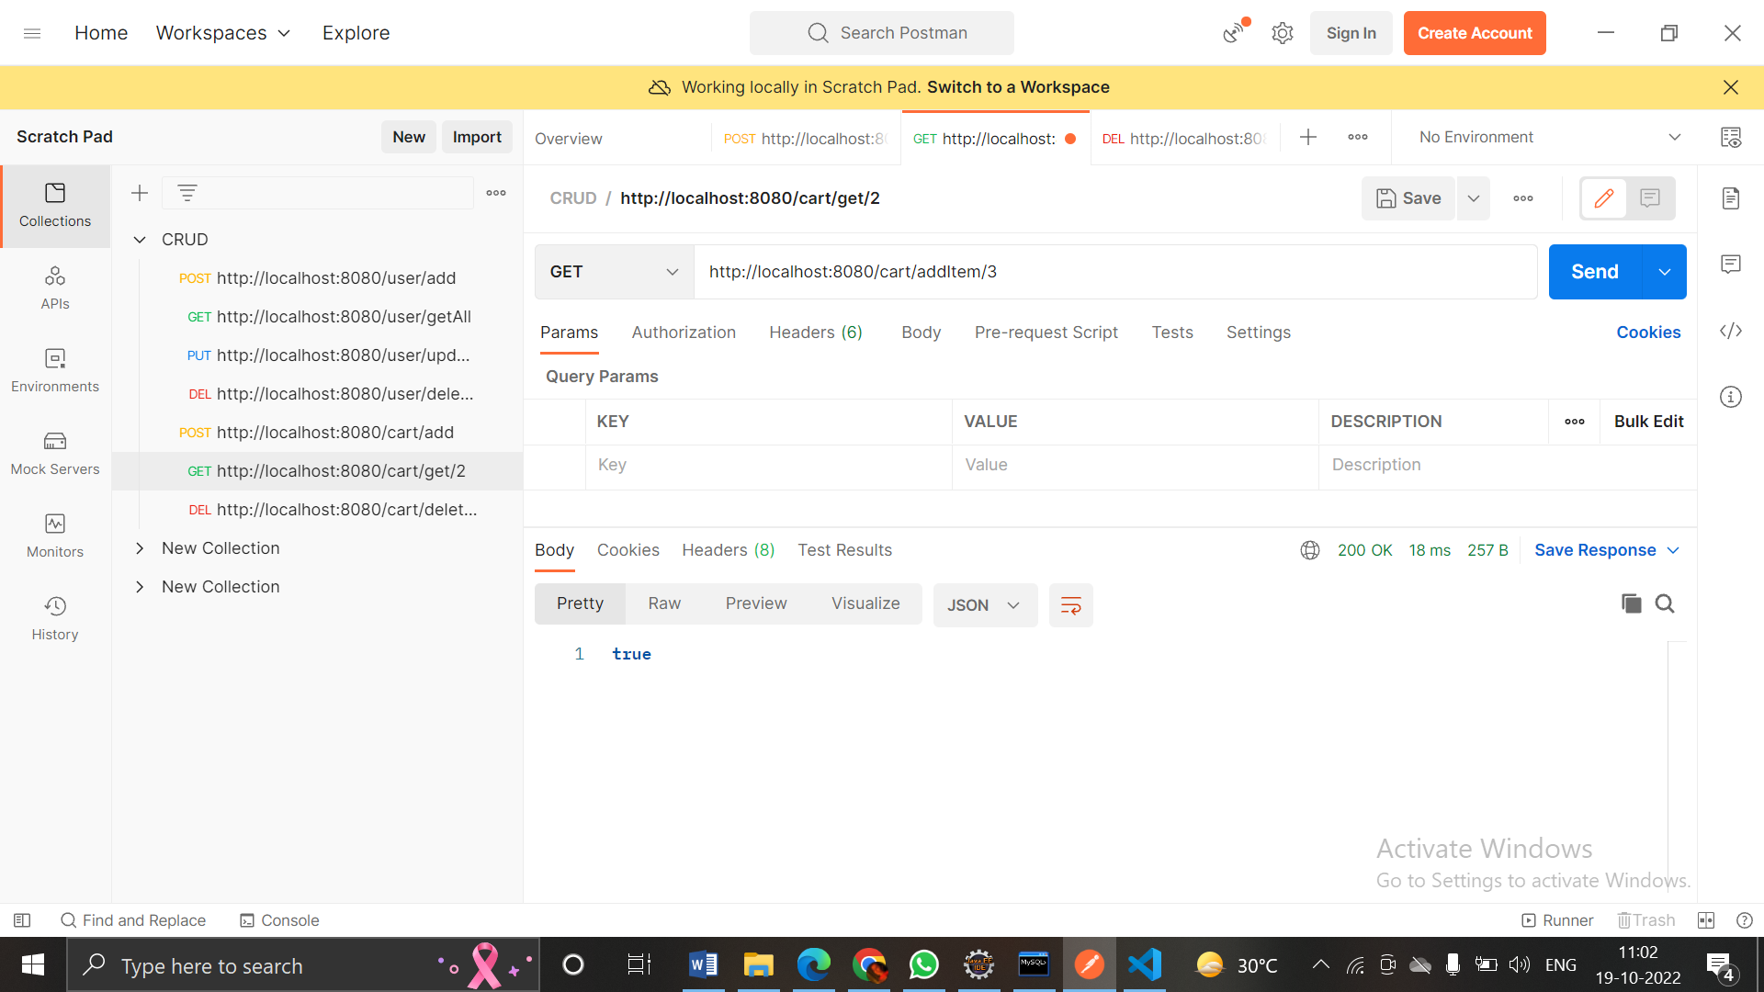
GET:
(addItem) -> updates the quantity

Slide 51
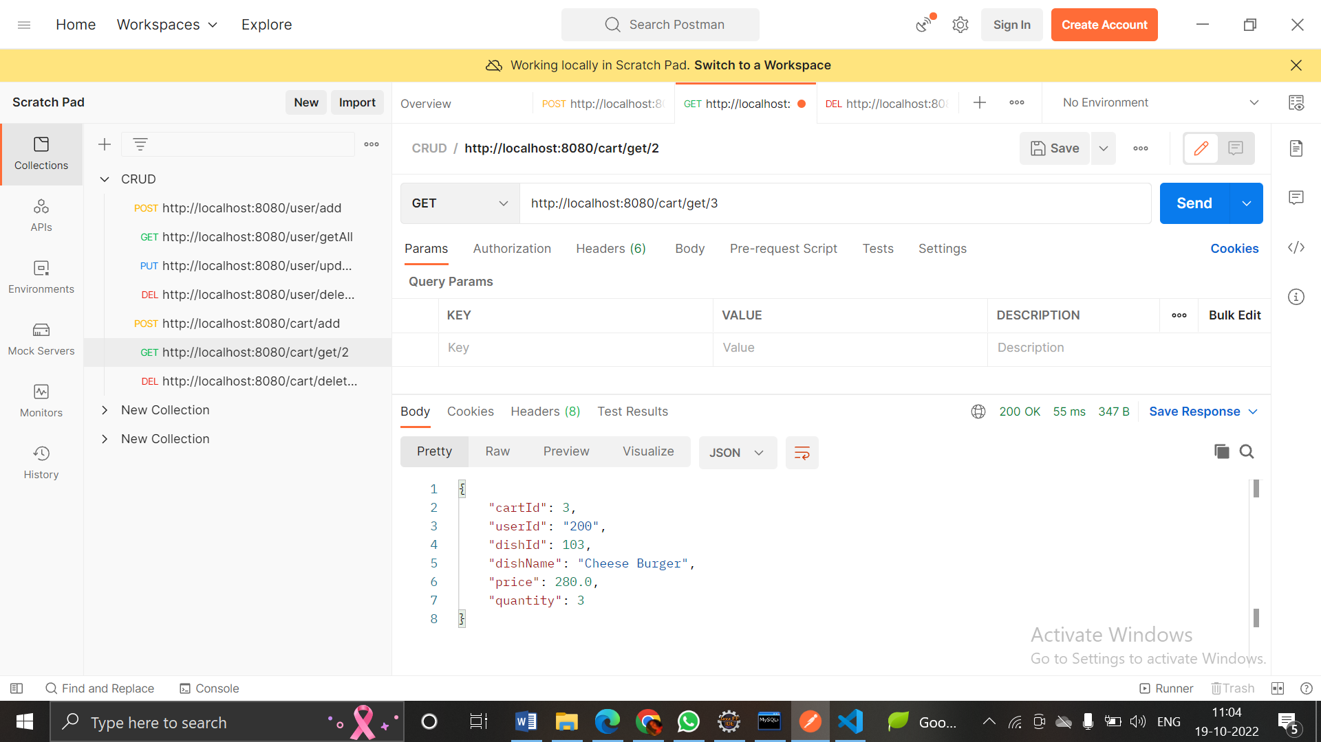

Slide 52
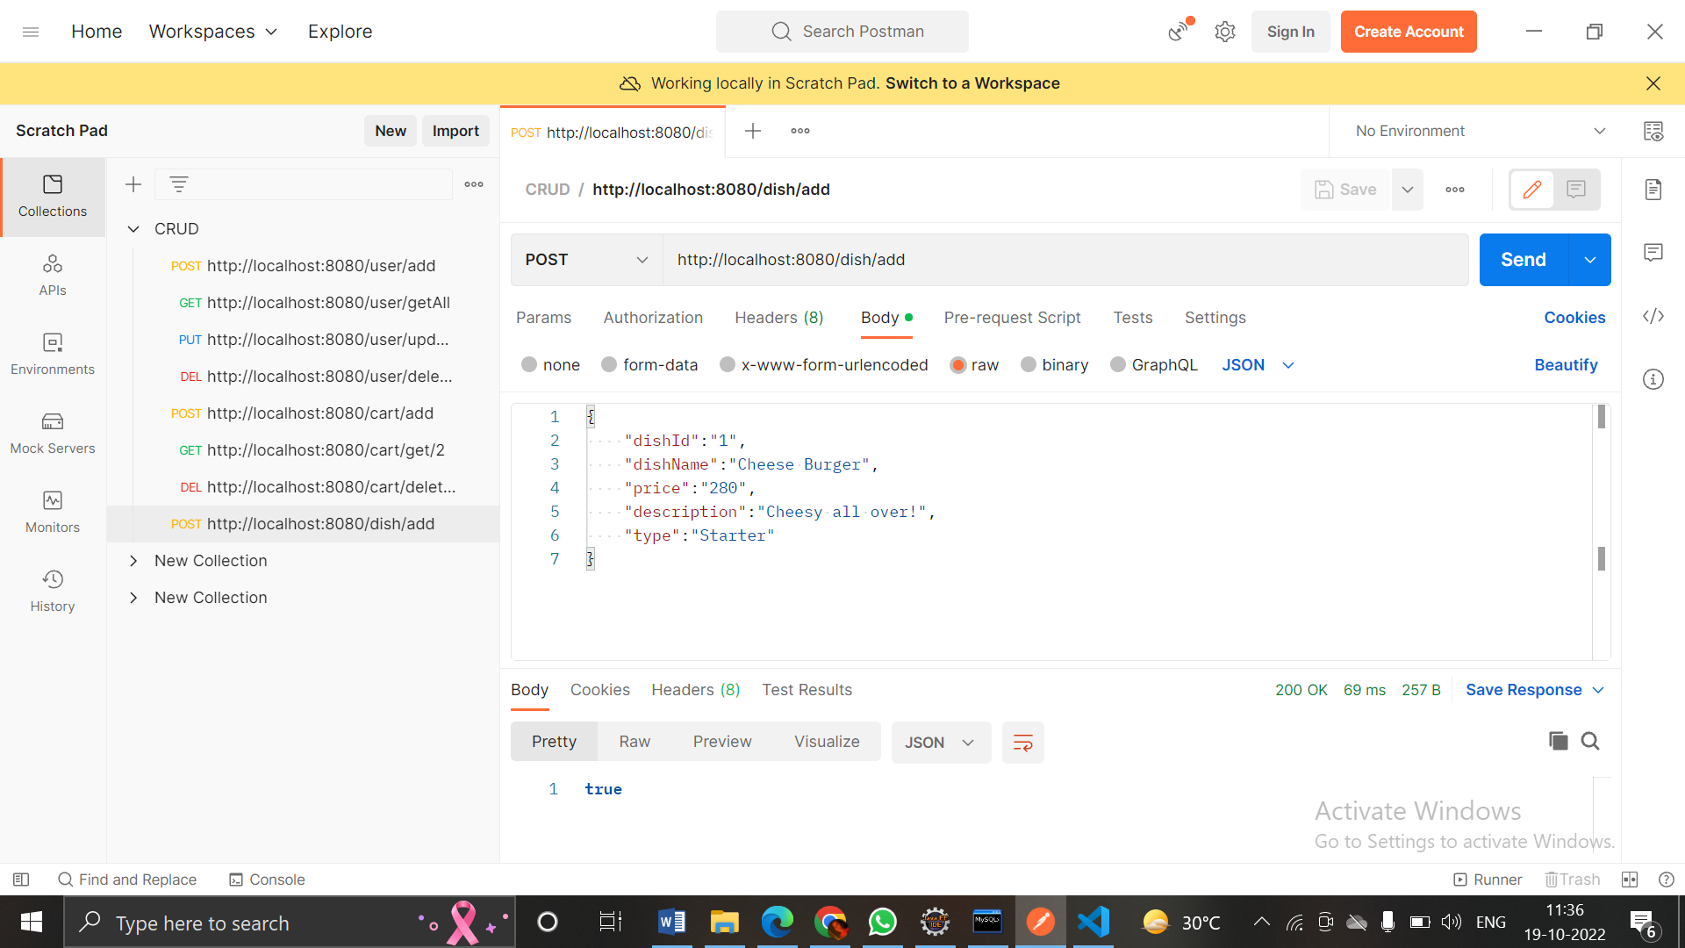
DISH
POST:

Slide 53
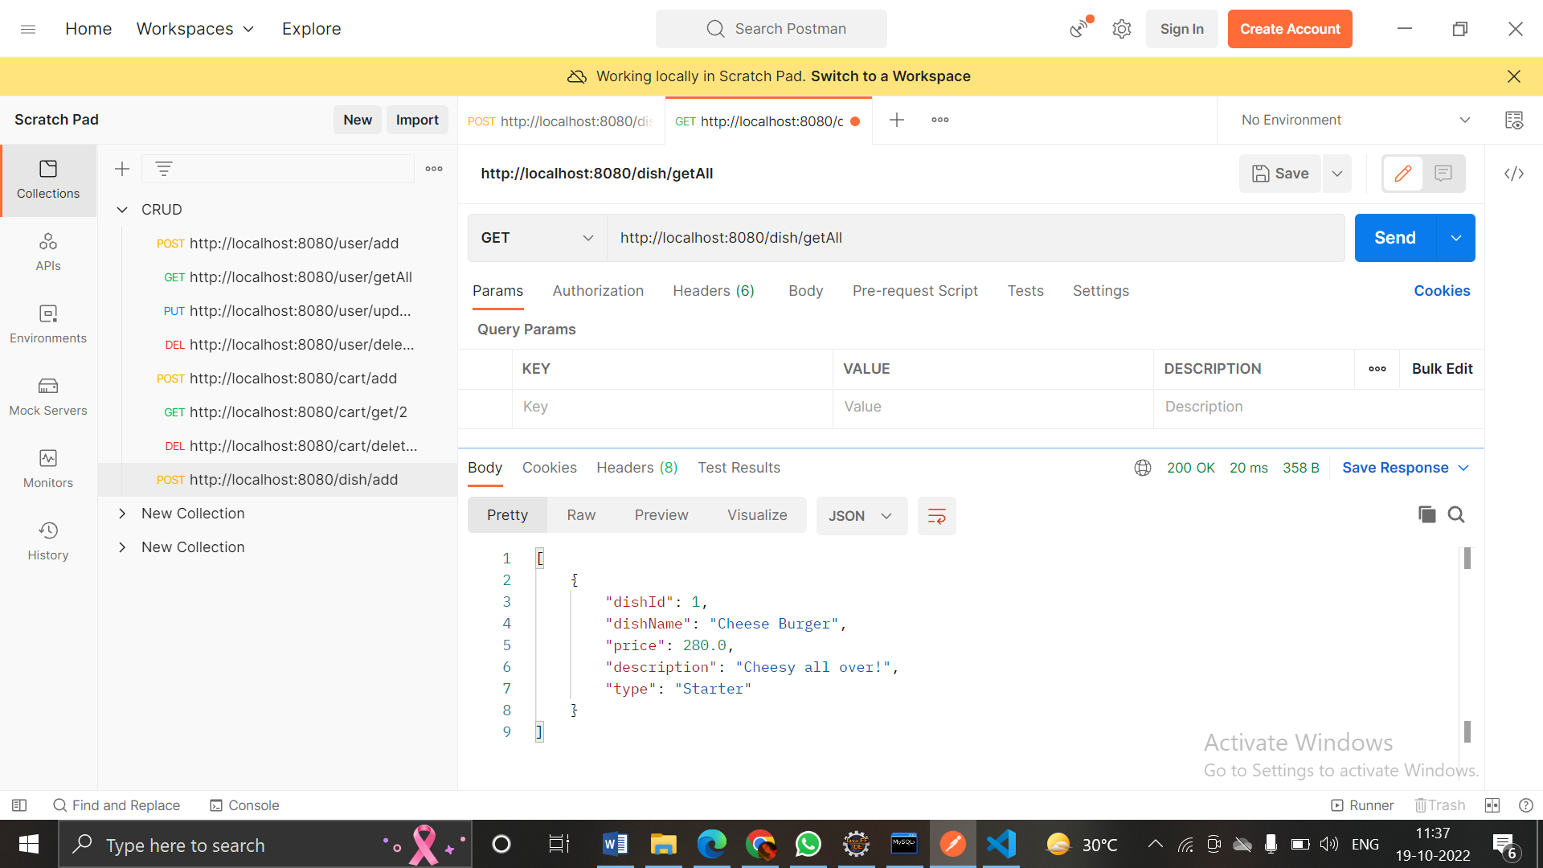
GET:

Slide 54
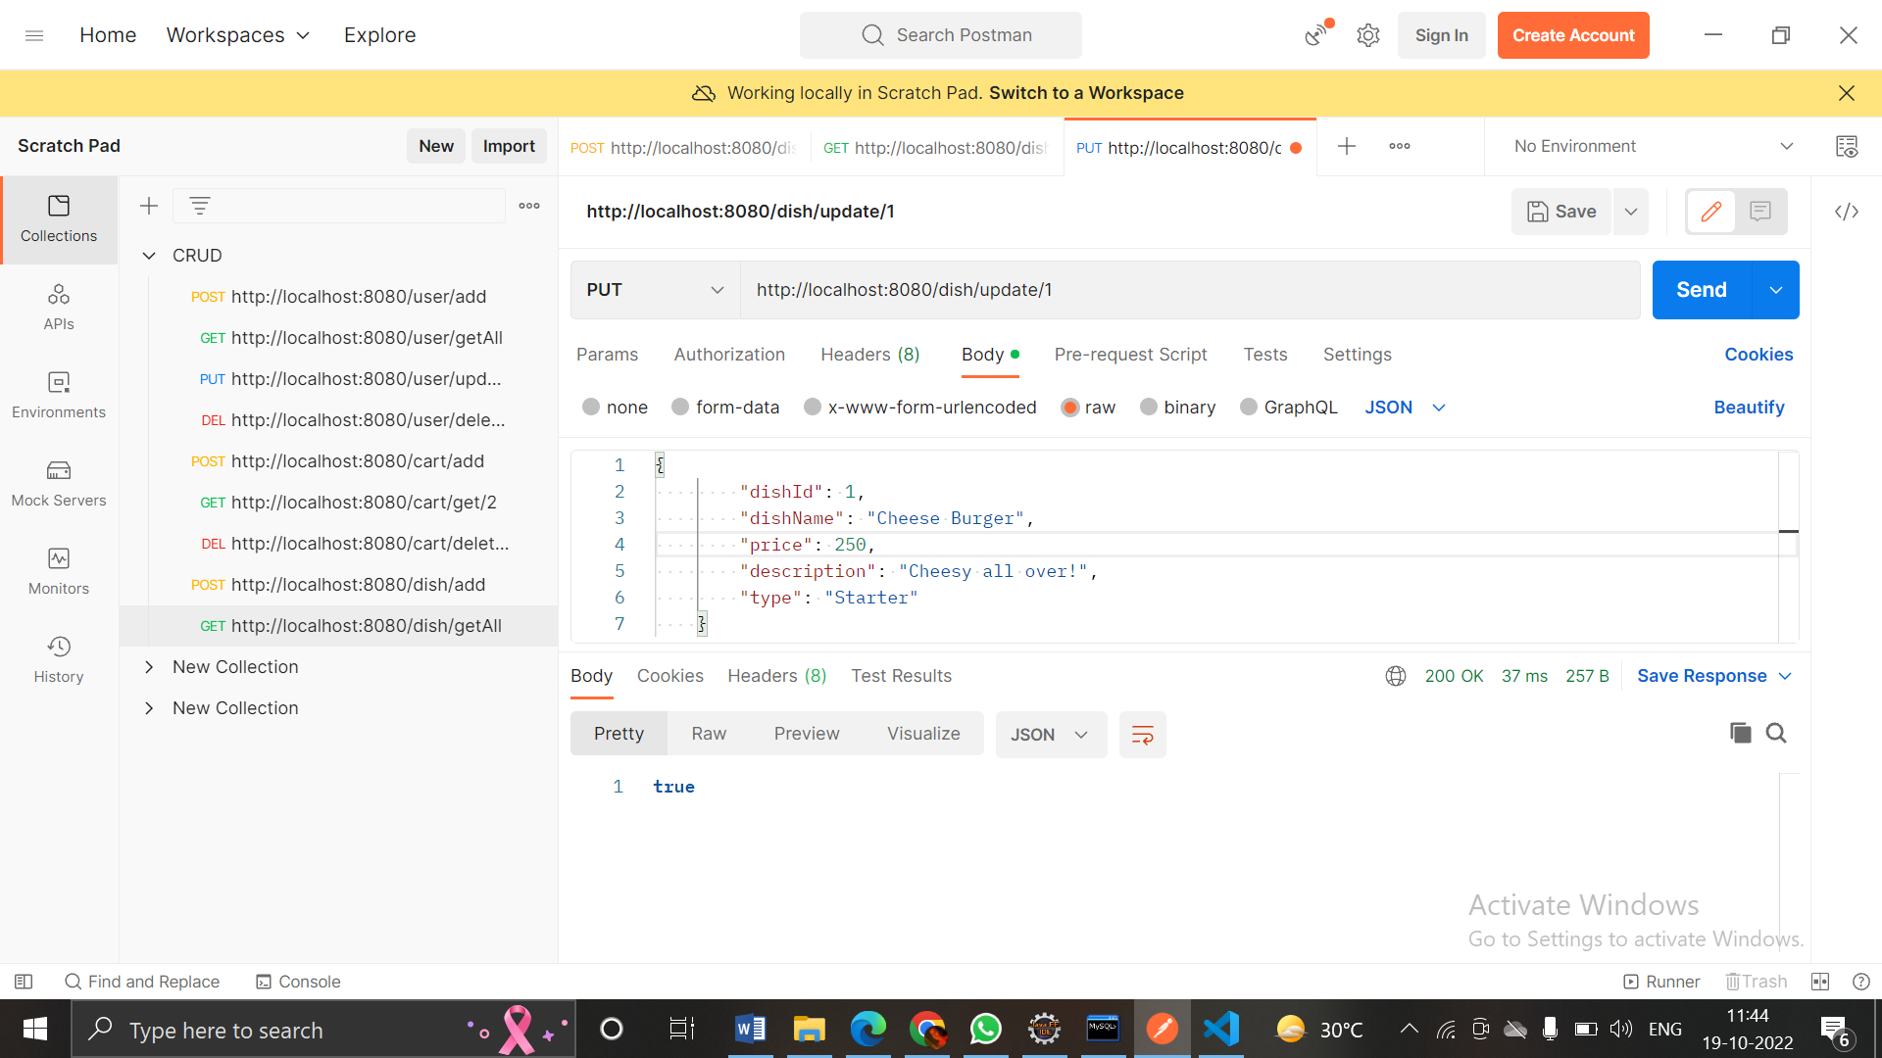
PUT:

Slide 55
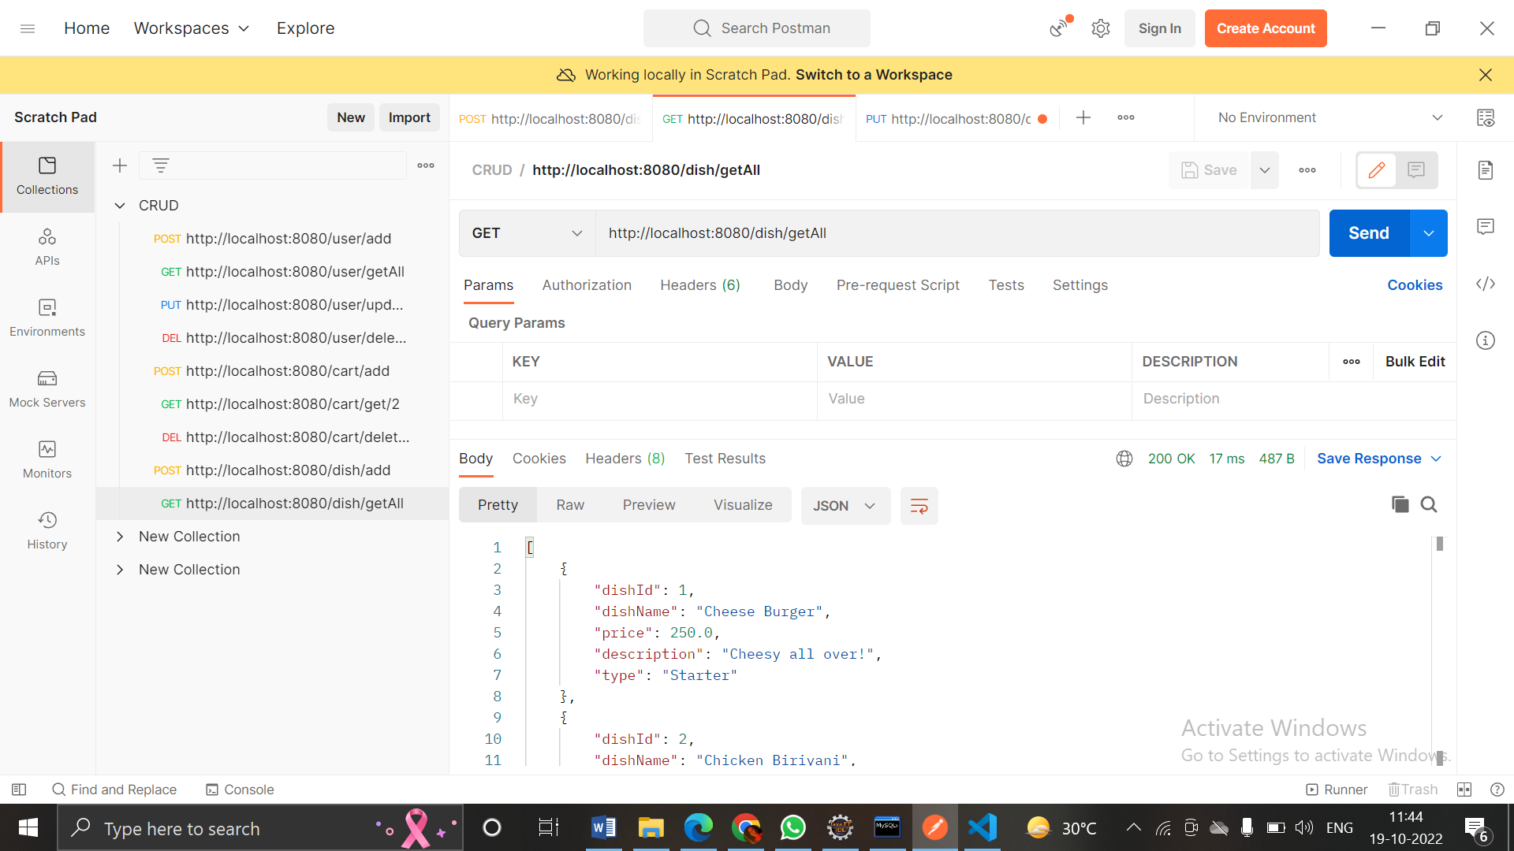

Slide 56
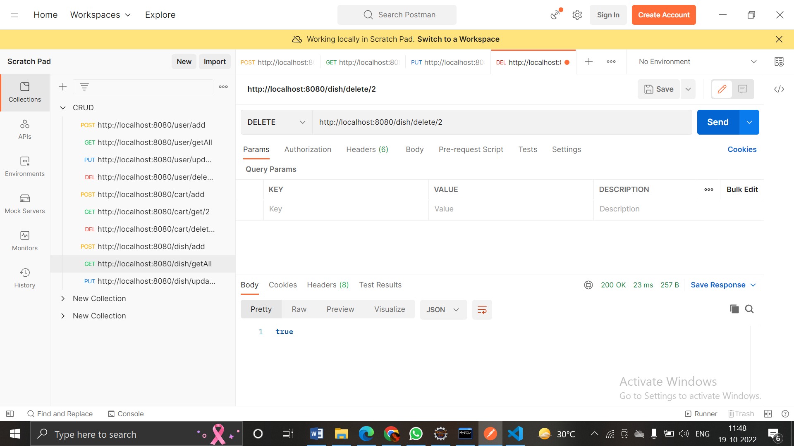
DELETE:

Slide 57
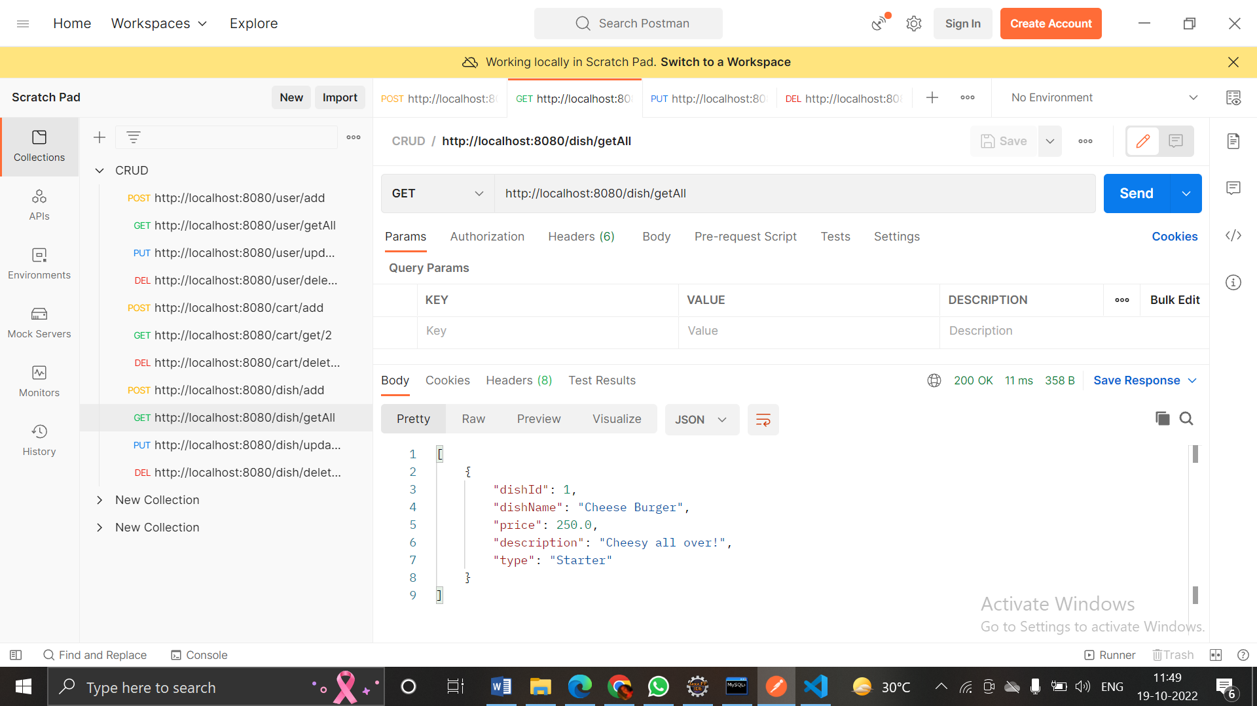

Slide 58
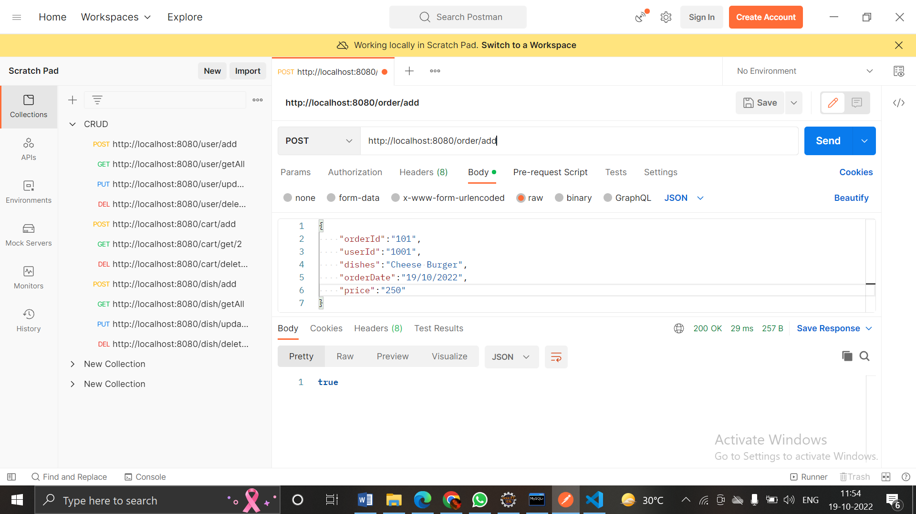
ORDER
POST:

Slide 59
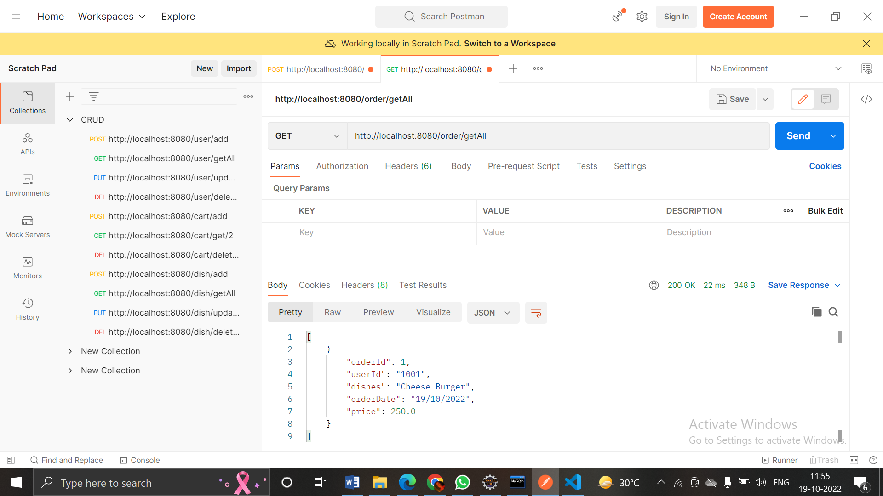
GET:

Slide 60
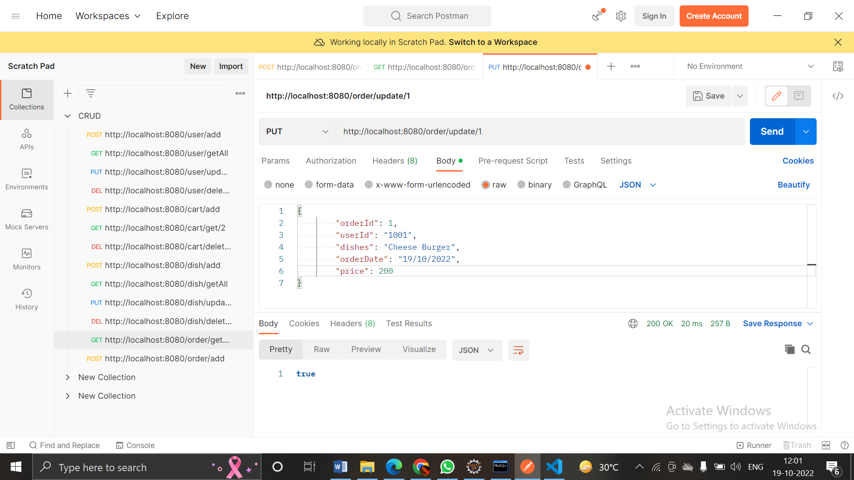
PUT:

Slide 61


Slide 62

DELETE:

Slide 63


Slide 64


